Slide 1
Vibrant Pregnancy-Vibrant Baby
Strategies for an enjoyable pregnancy before and after baby arrives.

Slide 2
Empowered Pregnancy vs. Fear Based Pregnancy

Slide 3
The Three Dimensions of Stress:
Physical Move Well
Chemical Eat Well
Emotional Think Well
We must become Pure and Sufficient in all Three!
mercola.com
Subscribe to The World's #1 Natural Health Website

Slide 4
Pregnancy and exercise: Baby, let's move!
During pregnancy, exercise can help you stay in shape and prepare for labor and delivery. Here's the lowdown on pregnancy and exercise, from getting started to staying motivated.
By Mayo Clinic Staff
Pacing it for pregnancy
For most pregnant women, at least 30 minutes of moderate exercise is recommended on most, if not all, days of the week.
Walking is a great exercise for beginners. It provides moderate aerobic conditioning with minimal stress on your joints. Other good choices include swimming, low-impact aerobics and cycling on a stationary bike. Strength training is OK, too, as long as you stick to relatively low weights.
Remember to warm up, stretch and cool down. Drink plenty of fluids to stay hydrated, and be careful to avoid overheating.
Intense exercise increases oxygen and blood flow to the muscles and away from your uterus. In general, you should be able to carry on a conversation while you're exercising. If you can't speak normally while you're working out, you're probably pushing yourself too hard.
Depending on your fitness level, consider these guidelines:
You haven't exercised for a while. Begin with as little as five minutes of physical activity a day. Build up to 10 minutes, 15 minutes, and so on, until you reach at least 30 minutes a day.
You exercised before pregnancy. You can probably continue to work out at the same level while you're pregnant — as long as you're feeling comfortable and your health care provider says it's OK.
June 09, 2016

Slide 5
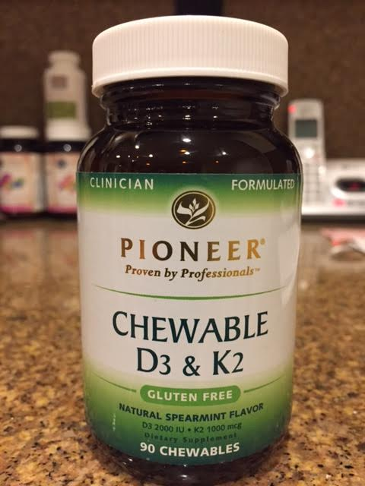
Vitamin D Deficiency During Pregnancy Raises Your Child’s Risk for Autism
December 28, 2016
Story at-a-glance
Recent research shows vitamin D deficiency during pregnancy is associated with an increase in autism-related traits in 6-year-old children. Deficiency was defined as vitamin D level below 25 nmol/L (10 ng/mL)
Vitamin D regulates a gene responsible for conversion of tryptophan into serotonin. Serotonin is crucial during fetal brain development. When vitamin D is lacking, low serotonin can produce neurological defects
Vitamin D optimization during pregnancy may also cut your risk of premature birth in half, and lower your child’s risk of multiple sclerosis
¹ CDC.gov, National Health Statistics Report, Number 65, March 20, 2013 (PDF)
² NVIC.org April 10, 2013
³ MMWR April 1, 2016 / 65(3);1–23
^{4,} ⁷ CDC Autism Data and Statistics
⁵ Chandramd.com
⁶ Autism Speaks November 13, 2015
⁸ Jeffhaysfilms.com Half of All Children Will Be Autistic by 2025, Warns Senior Research Scientist at MIT
⁹ Molecular Psychiatry November 29, 2016, doi: 10.1038/mp.2016.213
¹⁰ The Vitamin D Society December 13, 2016
¹¹ Yahoo News December 14, 2016
¹² The Guardian December 13, 2016
¹³ New York Post December 14, 2016
¹⁴ Medicalxpress.com December 14, 2016
¹⁵ International Business Times December 14, 2016
¹⁶ Sydney Morning Herald December 14, 2016
¹⁷ New Atlas December 14, 2016
¹⁸ Cochrane Database of Systematic Review
^{19,} ²¹ FASEB Journal 2014 Jun;28(6):2398-413
²⁰ FASEB Journal 2015 Jun;29(6):2207-22
²² Medicalxpress.com November 30, 2016
²³ Neurology Advisor December 9, 2016
²⁴ Aanem.org Abstracts
²⁵ Multiple Sclerosis Today November 3, 2014
²⁶ Aanem.org
²⁷ Greenmedinfo.com Multiple Sclerosis
²⁸ March of Dimes Impact of Premature Birth on Society
²⁹ March of Dimes, Vitamin D to Combat Preterm Birth
³⁰ Obstetrics and Gynecology 2013 Jul;122(1):91-8
³¹ Journal of Steroid Biochemistry and Molecular Biology November 10, 2015 [Epub ahead of print]
³² PR Web November 20, 2015
³³ Grassrootshealth.org Graphic (PDF)
³⁴ Obstetrics and Gynecology 2015 Feb;125(2):439-47
Mounting research indicates that brain disorders are the result of excessive exposure to toxins, including the commonly used weed killer Roundup, both during pregnancy and after birth.

Slide 6
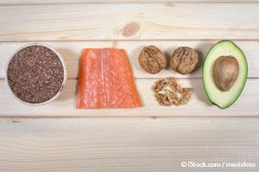
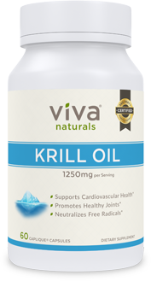
Omega-3s Have 230 Percent Return on Investment
[-] Sources and References
Medical Express November 17, 2016
Nutritional Outlook June 20, 2016
Medical Express November 14, 2016
Web MD November 13, 2016
Aker Biomarine November 22, 2016
Marine Stewardship Council January 9, 2015
Food Supplements Europe
¹ EurekAlert November 14, 2016
² Web MD November 13, 2016
³ Today’s Dietician May 2015
⁴ University of Glasgow November 16, 2016
^{5,} ^{6,} ^{7,} ¹¹ Medical Express November 17, 2016
⁸ Nutritional Outlook June 20, 2016
⁹ Indian Journal of Clinical Biochemistry January 6, 2011
¹⁰ Livestrong May 17, 2015
¹² Wellwise 2013
¹³ Neptune Wellness Corporation October 22, 2014
¹⁴ Food Supplements Europe
¹⁵ Nutrients 2014 February;6(2):799-814
¹⁶ Aker Biomarine November 22, 2016
¹⁷ Marine Stewardship Council January 9, 2015
¹⁸ "Aker BioMarine Receives an 'A' Rating from SFP," AkerBioMarine, September 1, 2016
¹⁹ Antarctic Wildlife Research Fund January 5, 2015
Post your comment

Slide 7
Optimizing Omega-3 and Vitamin D During Pregnancy May Reduce Asthma in Your Child
January 09, 2017 |
As they reduce the inflammatory response in your body, omega-3s can be helpful for those suffering with rheumatoid arthritis, reducing stiffness and pain.¹⁸ | They help your body build healthy muscle mass, including people suffering from cancer who may experience cachexia.¹⁹ In one study involving patients with advanced malignancy, those taking fish oil were able to gain weight. The length of time patients took the supplement was also a factor; the longer they took it, the better the results.
Omega-3 fats can also help improve your bone strength by improving the utilization of calcium in your body. This may lead to a reduction in the development of osteoporosis.²⁰ | Women who suffer from menstrual pain may also experience milder pain.^{21,22}
Improvements have been demonstrated in metabolic syndrome²³ and insulin resistance.²⁴ | Reduction of your triglyceride levels may lower your risk for type 2 diabetes and cardiovascular disease.²⁵
Demonstrated benefits have been shown for children with attention deficit hyperactivity disorder (ADHD), including reduced aggression, hyperactivity,²⁶ impulsivity,²⁷ oppositional behavior²⁸ and restlessness.²⁹ | Studies have demonstrated benefits of omega-3 in reducing the symptoms of depression, heart disease, Reynaud's and lupus.³⁰
DHA, perhaps the most important component of omega-3, is a major structural element in your eye and brain.³¹ | Reduced risk of Parkinson's disease and Alzheimer's disease is associated with omega-3s.
In patients at high risk for schizophrenia, it may delay progression to psychosis. | Omega-3 is associated with reduced risk of death from ALL causes.
Omega-3 is associated with lowered risk for other neurological/cognitive dysfunction, including: memory loss, brain aging, learning disorders and ADHD,³² autism and dyslexia.³³ | Reduced risk of kidney disease has been shown with omega-3.³⁴
Omega-3 is associated with reduced risk of Crohn's disease. | Reduced risk of colon cancer is associated with omega-3.³⁵
Low levels of DHA may increase the risk for reduction in processing speed and poor eye hand coordination by age 4,³⁶ age related macular degeneration³⁷ and vascular instability.³⁸ | Improved mood regulation may also be a factor with omega-3s.

Slide 8
Culprits of Autism Identified: Toxins, Gut Bacteria, Nutritional Deficiencies, and Vaccines Made with Human Fetal Cell Lines
¹ Autismsciencefoundation.org
² Fourteenstudies.org
³ CDC.gov, National Health Statistics Report, Number 65, March 20, 2013 (PDF)
⁴ Experience L!fe June 2013
⁵ Scientific American August 14, 2014
⁶ PLOS ONE October 9, 2013 [Epub ahead of print]
⁷ Caltech December 5, 2013
⁸ Scientific American August 14, 2014
⁹ Caltech December 5, 2013
¹⁰ Journal of Physiological Anthropology 2014, 33:2 (PDF)
¹¹ American Journal of Epidemiology September 22, 2014 [Epub ahead of print]
¹² UC Davis Health System September 21, 2014
¹³ The Scotsman September 26, 2014
¹⁴ Journal of Public Health and Epidemiology September 2014: 6(9); 271-284 (PDF)
¹⁵ Globalresearch.org September 8, 2014
¹⁶ Jon Rappaport August 22, 2014
¹⁷ FDA Powerpoint: Issues Associated With Residual Cell-Substrate DNA
Story at-a-glance
Three decades ago, autism affected one in 10,000 children. Today, autism is estimated to afflict as many as one in 50
Researchers are now starting to understand how a child’s microbiome can play an important role, either by exacerbating or even causing autistic symptoms. New studies suggest restoring microbial balance may alleviate autistic symptoms
Autistic children have distinctly different microbiome compared to healthy children. Studies show they have fewer healthy bacteria, and markedly higher levels of toxic volatile organic compounds (VOCs)
The Gut and Psychology Syndrome (GAPS) Nutritional Program is designed to promote healthy gut flora and restore the integrity of your gut lining
Recent research also reveals that increases in autistic disorder correspond with the introduction of vaccines using human fetal cell lines and retroviral contaminants

Slide 9
Asthma & Allergies
Study: Living With Pets May Protect Infants From Allergies
By Amanda Gardner/Health.com June 13, 2011
Follow @TIMEHealth
Children who live with dogs and cats are less likely to develop allergies to those animals later in life, but only if the pet is under the same roof while the child is still an infant, a new study suggests.
Though they can’t say for sure, the researchers suspect that early exposure to pet allergens and pet-related bacteria strengthens the immune system, accustoms the body to allergens, and helps the child build up a natural immunity.
“Dirt is good,” says lead researcher Ganesa Wegienka, Ph.D., summing up the theory. “Your immune system, if it’s busy with exposures early on, stays away from the allergic immune profile.”

Slide 10
The germ is nothing, the terrain is everything. Pasteur

Slide 11
Nourishing Your Gut Bacteria Is Critical for Health and Mental Well-Being
March 13, 2016 | 344,407 views
Story at-a-glance
One of the best and least expensive ways to optimize your gut microbiome is to eat traditionally fermented and fiber-rich foods. Probiotic supplements can also be beneficial
One of the reasons a healthy diet is able to influence your health is by creating an optimal environment for beneficial bacteria in your gut, while decreasing pathogenic or disease-causing bacteria, fungi, and yeast
If you have to take an antibiotic, be sure to also take a high-quality probiotic. To ensure the bacteria’s survival, take the probiotic a few hours before or after taking the antibiotic
Probiotics and the Gut-Brain Axis
It's become quite clear that the benefits of probiotics transcend the gut. More recent studies have delved into the role of gut bacteria in the workings of the gut-brain axis, and how they benefit your mental and psychological health. Anxiety, depression and other mood disorders are increasingly recognized as being, in part, related to an unbalanced microbiome.
Probiotics appear to have the ability to make compounds called neuropeptides that interact directly with your brain. Probiotics certainly influence your immune system by way of modulating inflamation, which has interactions with and can cross the blood-brain barrier.
"There's an interesting study where people gave infants probiotic bacteria for the first two years of their life," Leyer says. "They were really looking at the ability of this probiotic to ward off the incidence of atopic eczema or skin rashes.
When the kids were 13 years old, they went back and said, 'Okay. Let's look at autistic spectrum disorder, attention-deficit hyperactivity disorder (ADHD), and [other] psychological kind of issues and ask if there is a relationship between those children who were administered the probiotic early in life, and incidence.'
Of the kids that took the probiotic, none had developed any kind of autistic spectrum disorders; 17 percent of those that did not get probiotics developed autistic spectrum disorders. The study wasn't designed to look at ADHD or autism, but it's an interesting way to look back in time and say:
Here's a population of people that were essentially imprinted with probiotic bacteria at a very young age. We now understand better that there's this developmental window in young people that's critically important for longer term health."

Slide 12
Comparison of Human Milk and Formula
NUTRIENT FACTOR | BREAST MILK CONTAINS | FORMULA CONTAINS | COMMENT
Fats | Rich in brain-building omega 3s, namely DHA and AA -Automatically adjusts to infant’s needs; levels decline as baby gets older -Rich in cholesterol -Nearly completely absorbed -Contains fat-digesting enzyme, lipase | -No DHA -Doesn’t adjust to infant’s needs -No cholesterol -Not completely absorbed -No lipase | Fat is the most important nutrient in breastmilk; the absence of cholesterol and DHA, vital nutrients for growing brains and bodies, may predispose a child to adult heart and central nervous system diseases. Leftover, unabsorbed fat accounts for unpleasant smelling stools in formula-fed babies.

Slide 13
Protein | -Soft, easily-digestible whey -More completely absorbed; higher in the milk of mothers who deliver preterm -Lactoferrin for intestinal health -Lysozyme, an antimicrobial -Rich in brain-and-body- building protein components -Rich in growth factors -Contains sleep-inducing proteins | -Harder-to-digest casein curds -Not completely absorbed, more waste, harder on kidneys -No lactoferrin, or only a trace -No lysozyme -Deficient or low in some brain-and body-building proteins -Deficient in growth factors -Does not contain as many sleep-inducing proteins. | Infants aren’t allergic to human milk protein.

Slide 14
Carbohdrates | -Rich in lactose -Rich in oligosaccharides, which promote intestinal health | -No lactose in some formulas -Deficient in oligosaccharides | Lactose is considered an important carbohydrate for brain development. Studies show the level of lactose in the milk of a species correlates with the size of the brain of that species.
Immune Boosters | -Rich in living white blood cells, millions per feeding -Rich in immunoglobulins | -No live white blood cells-or any other cells. Dead food has less immunological benefit. -Few immunoglobulins and most are the wrong kind | When mother is exposed to a germ, she makes antibodies to that germ and gives these antibodies to her infant via her milk.
Vitamins and Minerals | -Better absorbed, especially iron, zinc, and calcium -Iron is 50 to 75 percent absorbed. -Contains more selenium (an antioxidant) | -Not absorbed as well -Iron is 5 to 10 percent absorbed -Contains less selenium (an antioxidant) | Vitamins and minerals in breast milk enjoy a higher bioavailability-that is, a greater percentage is absorbed. To compensate, more is added to formula, which makes it harder to digest.
Enzymes and Hormones | -Rich in digestive enzymes, such as lipase and amylase -Rich in many hormones: thyroid, prolactin, oxytocin, and more than fifteen others -Varies with mother’s diet | -Processing kills digestive enzymes -Processing kills hormones, which are not human to begin with -Always tastes the same | Digestive enzymes promote intestinal health. Hormones contribute to the overall biochemical balance and well- being of baby. By taking on the flavor of mother’s diet, breastmilk shapes the tastes of the child to family foods.
Cost | -Around $600 a year in extra food for mother | -Around $1,200 a year -Up to $2,500 a year for hypoallergenic formulas -Cost for bottles and other supplies -Lost income when baby is ill

Slide 15
Chiropractic and Pregnancy

Slide 16
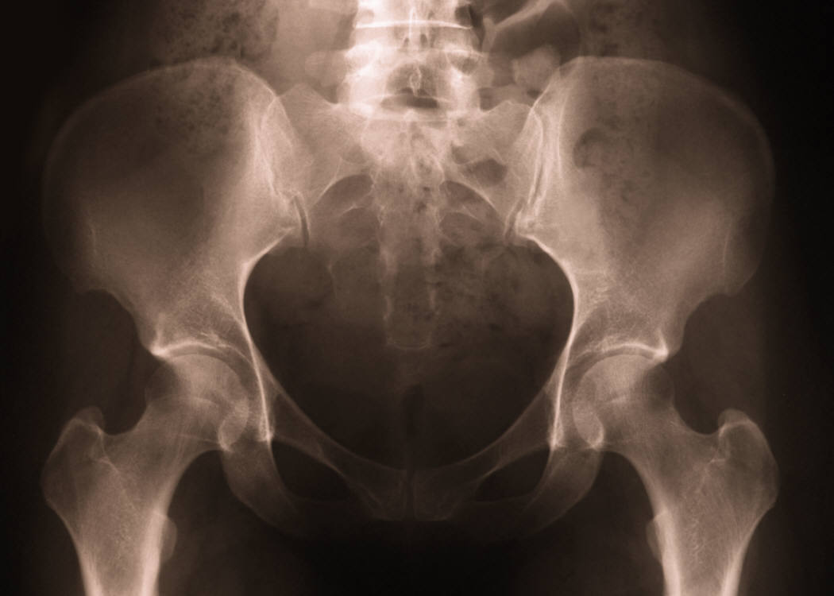
Balance is Key

Slide 17
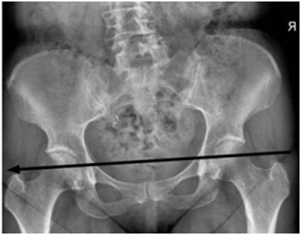

Slide 18
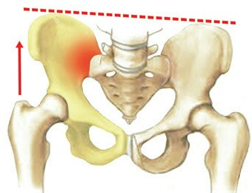

Slide 19
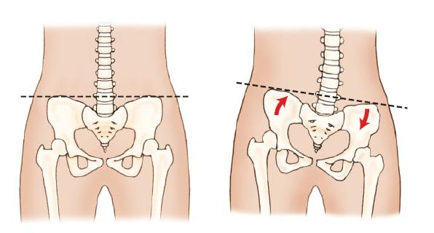
Distortion of the Pelvis, Hip Joints, Sacro Illiac Joints are a major cause of pain during pregnancy and a factor in baby not turning head down.

Slide 20
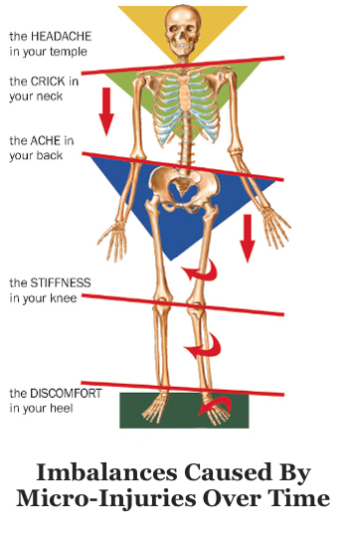
Pronation of the foot or feet will cause imbalances in the entire pelvis and spine.

Slide 21
Resolution of Breech Presentation Confirmed by Ultrasound Following Webster Technique: A Case Study & Review of Literature
Jason Cherry DC & Natalie Wilson, DC
Journal of Pediatric, Maternal & Family Health - Chiropractic ~ Volume 2016 ~ Issue 4 ~ Pages 104-117
Abstract
Objective: The purpose of this paper is to present the chiropractic management and care of a 27-year-old pregnant female with vertebral subluxation complex and breech fetal presentation.
Clinical Features: The patient presented to the private practice with complaints of pelvic alignment problems. A thorough history and examination was performed including thermography, postural analysis, range of motion, and palpation using the Webster’s technique. Pain, discomfort, abnormal posture and loss of range of motion in the lumbosacral region were found throughout the examination. The patient was diagnosed with vertebral subluxation complex of the sacral region.
Intervention and Outcomes: Utilizing the Webster’s technique to adjust the patient’s sacrum, Logan technique and pressure applied to the round ligament the patient noticed a change in the baby’s position after the first adjustment. The patient was adjusted manually once and the fetal position was confirmed to have turned from a breech fetal position to a vertex fetal position by ultrasound after one week of care.
Conclusion: This case demonstrated safe, quick and effective chiropractic care for a pregnant female with abnormal fetal position. Utilizing Webster’s technique to adjust vertebral subluxations allowed the patient to have a normal vaginal birth without medical intervention such as cesarean section or external cephalic version.

Slide 22
Chiropractic and Infants

Slide 24
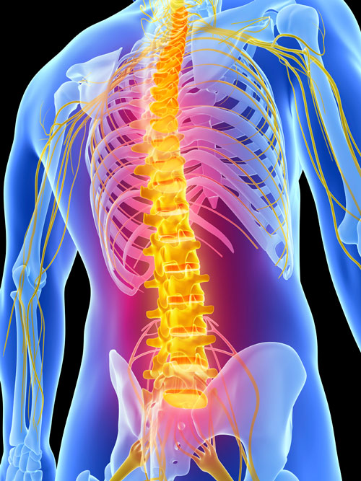
Your Lifeline – The Spine and Nerve System

Slide 25
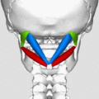
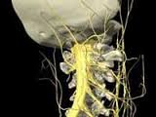
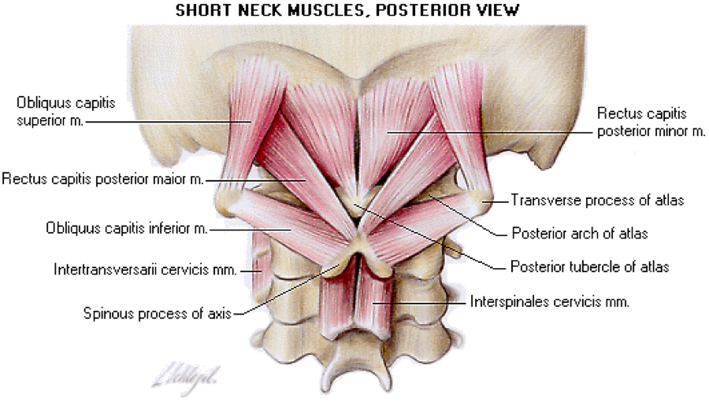

Slide 26
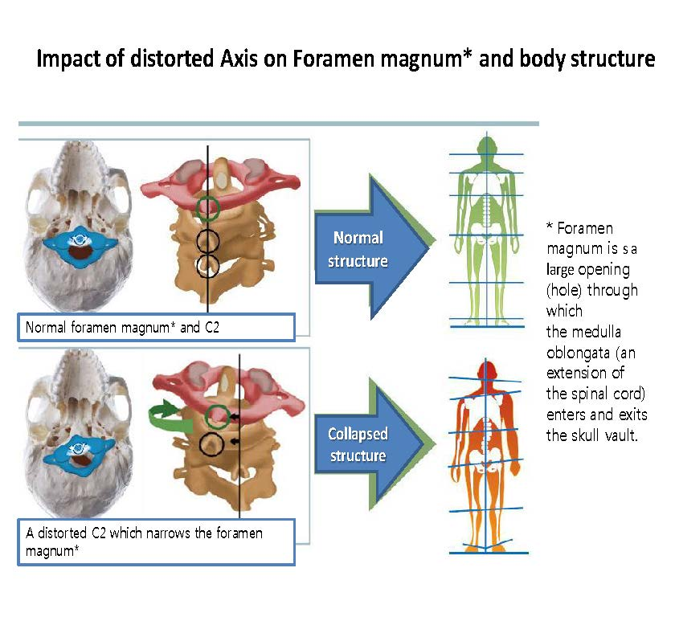

Slide 27
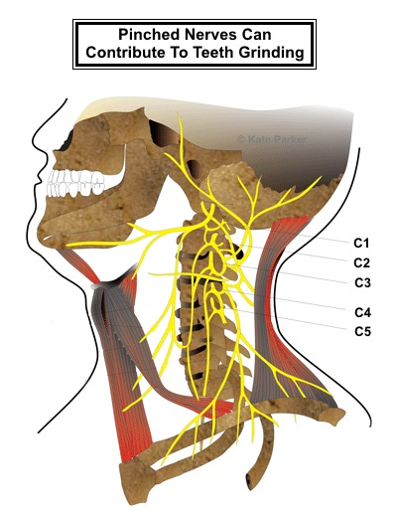
Coordination of the jaw and suckling reflex are directly related to nerve disturbances.

Slide 28
KISS syndrome
• What is KISS syndrome? KISS is the abbreviation for: Kopfgelenk Induzierte Symmetrie Störungen.
This German acronym is also known in English as “Kinetic Imbalances due to Suboccipital Strain”.
This means that there are functional problems with the upper vertebrae of the neck which can disturb the symmetrical development of the baby or the growing child.
Traumatic Birth
Possible causes of KISS
At delivery: ‐premature birth ‐twins, triplets, etc ‐prolonged or difficult delivery ‐very rapid delivery ‐malposition in the uterus ‐delivery with forceps or ventouse ‐emergency caesarean section ‐prolapsed umbilical cord ‐premature rupture of the membranes ‐blue baby ‐prenatal trauma ‐low birth weight

Slide 29
Tight Baby Syndrome
Early signs of KISS ‐the back is often curved ‐marked tendency to arch the back ‐asymmetric development of the hips ‐asymmetric movements of the arms and legs ‐development of asymmetric skull ‐difficulty in swallowing and a tendency to vomit ‐frequent tears of protestation when getting dressed and undressed ‐always sleeps in the same position ‐head tilted to one side with a bald patch on one side ‐the child does not like to be cuddled
‐bouts of unexplained fever ‐abnormal sucking and swallowing reflex ‐poor appetite, difficulties in feeding/eating. ‐The infant feeds normally at the breast but refuses anything else and cries constantly… ‐the child cries a lot and sleeps badly ‐the child tries to stand up very early ‐the child skips the crawling stage ‐the child is late learning to walk ‐neck straight and flattened ‐exaggerated extension of one foot ‐difficulty holding the head straight and erect ‐generally weak muscle tone ‐flattened back of the head

Slide 30
Later signs of KISS ‐problems with balance ‐poor posture ‐the child falls or staggers frequently ‐it always or frequently walks on tiptoe ‐tiredness ‐atypical stomach ache ‐fatigue, lack of energy ‐sleep problems: difficulty falling asleep, restless sleep, little sleep… ‐trouble concentrating, quickly forgetting a given task, variable school results ‐migraines ‐recurring headaches, or headaches on waking up ‐neck pain and stiffness, ‐back pain ‐changes in behaviour: easily discouraged, temper tantrums, uncertainty, nervousness, demanding a lot of attention ‐very slow general and fine motor function development ‐growing pains ‐Tourette’s syndrome (tics, teeth grinding,…) ‐delay in learning words

Slide 31
CASE STUDY
Resolution of Birth Trauma Sequelae Following Adjustment of Vertebral Subluxations in an Infant
David H. Spear, PhD, DC & Joel Alcantara, DC
Journal of Pediatric, Maternal & Family Health - Chiropractic ~ Volume 2016 ~ Issue 1 ~ Pages 28-31
Abstract
Objective: To describe the chiropractic care of an infant with vacuum extraction induced birth trauma and a diagnosis of infantile colic and acid reflux.
Clinical Features: A 6-week-old infant boy presented with chief complaint of infantile colic, acid reflux, restlessness, inability to relax and/or lay on his back, difficulty sleeping and general irritability. Medical consultation resulted in a diagnosis of acid reflux and infantile colic and labeled as a “high needs baby.”
Intervention and Outcome: The patient received chiropractic care using Activator instrument and “touch and hold” adjustments for a total of 7 visits over 7 weeks. The patient’s presenting complaints resolved following a trial of care.
Conclusion: This case report provides supporting evidence on the effectiveness of chiropractic in children presenting with colic, acid reflux, sleeplessness and irritability. We support further research and documentation in this area of patient care.
Key words: Acid reflux, infantile colic, irritability, birth trauma, adjustment, spinal manipulation, chiropractic, vertebral subluxation

Slide 32
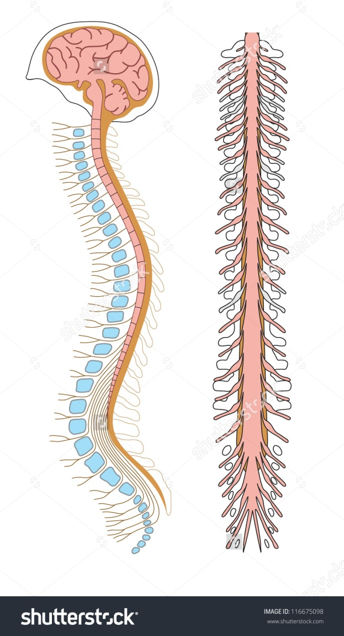
Tight Spinal Cords are a lot like tight guitar strings. And they work better at the right tension

Slide 33
TOTS
Tethered Oral Tissues

Slide 34
Our Core Values at Vibrant Life Chiropractic
Sustainability
Respect
Hope
Web Sites which may be helpful
Mercola.com
Icpa4kids.org

