Slide 1
Are We Moving Forward or Sliding Back?
Having the Data Skills to Know the Difference
Carol Melcher, MPH, BS, RN

Slide 2
Why track progress? To answer these questions…
Did my efforts make a difference?
Where did I start? Where did I end?
We track our progress every day.
Notes:
Thank you for stepping outside your comfort zone. If you were going on a diet to gain or lose weight, the first thing you would do is step on a scale. If you are going to to grocery store, you will think? Do I have enough money to buy what I need. If you are driving across town, you estimate, how long will it take to get there. These are all measures that you are tracking. Perhaps less formal, but they holp you know where you are going and if you are on track.

Slide 3
Will you survey, review charts, interview? Will you publish or share your results?
Most of your time will be spent preparing, designing and testing.
Notes:
Thank you for stepping outside your comfort zone. If you were going on a diet to gain or lose weight, the first thing you would do is step on a scale. If you are going to to grocery store, you will think? Do I have enough money to buy what I need. If you are driving across town, you estimate, how long will it take to get there. These are all measures that you are tracking. Perhaps less formal, but they holp you know where you are going and if you are on track.

Slide 4
Why is it important?
Data is power.
California is moving forward, because we can track our progress.
Notes:
Thank you for stepping outside your comfort zone. If you were going on a diet to gain or lose weight, the first thing you would do is step on a scale. If you are going to to grocery store, you will think? Do I have enough money to buy what I need. If you are driving across town, you estimate, how long will it take to get there. These are all measures that you are tracking. Perhaps less formal, but they holp you know where you are going and if you are on track.

Slide 5
Goals
Help you set up basic data systems to track your progress.
Help you share your results.
Help you avoid common mistakes.
Don’t worry, this will not be a statistics class!
Notes:
Statistics is a complicated set of measures and tests to determine what is “truth”. How many people live on the streets of LA? How many people live in the world?
We are using simple statistical tools to find trends, measure progress, test our assumptions, and find out where we are along a path knowing that we are always moving so we can never pinpoint our exact position.

Slide 6
First Things First- Collecting data
Your results are only as good as your data.

Slide 7
Let’s start with the hardest stuff…
Preparing for this work:
If you are conducting patient or staff interviews, I strongly recommend taking a 1-2 hour class on PROTECTING HUMAN SUBJECTS.
If you plan to publish, you need approval from an INTERNAL REVIEW BOARD (IRB)

Slide 8
Why do you need “Human Subjects” training?
To ensure you don’t overstep a patient’s rights.
To protect vulnerable people and health information.
To protect you and your work.
Notes:
I can help you avoid some of the pitfalls, but I will not be able to include everything you need to know in this training.

Slide 9
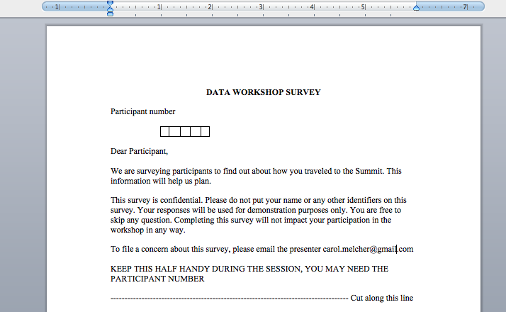
Informing your participant
This information could be done verbally if you are interviewing patients.
Notes:
This is a minimal. Your institution may require more details.

Slide 10
Quality Improvement (QI) vs Research
QI- sharing internally only.
HIPPA training required
QI team approval recommended
Data storage security recommended
IRB not required
Protecting Human Subjects training not required
Research- sharing with external groups.
HIPPA training required
Annual IRB review required
Data storage security required
IRB is required
Protecting Human Subjects training is required.

Slide 11
Why?
Vulnerable people (patients) may feel that participating could impact their care.
You must clearly separate her care from her survey responses. Example: Did your nurse teach you about your baby’s cues?
She must feel free to refuse to participate.
Nurses should never interview their own patients.
Notes:
If she says “No” and you turn to her nurse and say “Why didn’t she get skin-to-skin?” She could interpret this as harming her nurse or tattling on her care providers.
There are important precautions you will need to take to protect your participants. You will learn these in the “Protecting Human Subjects” class. Your QI department should be able to help you find a class.

Slide 12
WHEW!!
That is the hardest part, now let’s talk about the fun stuff.
Notes:
Your manager or nurse research committee should be able to easily help you. If they aren’t helpful, go on line and find a free class, National Institute of Health or Department of Public Health.

Slide 13
Notes:
Downton Abby: Dowager Countess” doesn’t want to be bothered with facts, she wants to remain in power”
Mrs. Crawley wants to be “In possession of the facts and do what is best for the patients. Even if it means giving up her power.”
This debate has been going on in hospitals for a long time.

Slide 14
DATA Collection TOOLs
You will likely conduct surveys, chart reviews, and in-person interviews.
Notes:
We must face our fears, and dive in. We may not like the results, we have to be willing to seek truth.

Slide 15
Types of data
Quantitative Data
Discrete-
Whole numbers, in clear categories.
Yes or no
Continuous-
Characteristics that can be measured. Such as length, diameter, time
Notes:
These are the two most common types of data you will be gathering. We will limit our discussion to these two types and how to collect, describe and present these two types of data.

Slide 16
Sample Survey Questions
Yes No
Try to design questions that do not imply a preferred response or a judgment.
Notes:
Question # 1- Discrete- Help participant feel that you care about their experience. We will count only the responses we want “Yes” (example skin-to-skin until first feeding)
Question # 2- Discrete- We only care about those who traveled solo by car. Multiple discreet options. We will enter all of the responses so we can compare.
Question # 3- We can compare type of travel with funding of travel. May be lots of fill-ins. We will have two groups (Example Vaginal birth vs C-sec)
Question # 4- Continuous variable. Anywhere from 1 mile to 5,000 miles are possible answers. (note, most participants will be guessing at this one) Most moms are going to have to guess at length of feeding, length of skin-to-skin, etc) We will need to validate this one.
Data sitting on shelves story…

Slide 17
Sample Questions
Biased Question:
“How did the breastfeeding class improve your experience?” (if asked by the teacher, it could have a strong bias)
Unbiased question:
“Which of the following words best describes the affect of the breastfeeding class on your breastfeeding experience? (Asked by someone other than the teacher)
Very Helpful | Somewhat Helpful | Neither Helpful or Unhelpful | Somewhat Unhelpful | Very Unhelpful
Notes:
Question # 1- Discrete- Help participant feel that you care about their experience. We will count only the responses we want “Yes” (example skin-to-skin until first feeding)
Question # 2- Discrete- We only care about those who traveled solo by car. Multiple discreet options. We will enter all of the responses so we can compare.
Question # 3- We can compare type of travel with funding of travel. May be lots of fill-ins. We will have two groups (Example Vaginal birth vs C-sec)
Question # 4- Continuous variable. Anywhere from 1 mile to 5,000 miles are possible answers. (note, most participants will be guessing at this one) Most moms are going to have to guess at length of feeding, length of skin-to-skin, etc) We will need to validate this one.

Slide 18
Defining your Methods

Slide 19
The “Methods Sheet”
Create a new sheet for each new data collection process.
Include how, what, when, where and who will gather the data.
Record your decisions about “cleaning” the data here.
Keep it simple, clear and use it to train your team.
Notes:
Example, if most of our participants the flew here, used a shuttle, this should probably not be ignored. We may even add a “Shuttle’ category to put the write-ins. If 80% of your nursing surveys are incomplete, you may need to use incomplete surveys. Very common with two-sided pages.

Slide 20
Sample Survey “Methods Sheet”
Notes:
The Methods sheet. Here is where all of the decisions you make, as you go along are kept. This is not complicated and there are no “correct answers, just what you decide along the way.

Slide 21
Conducting a Survey
Your “Methods Sheet” will tell you:
How, when and to whom the survey will be given.
How to enter the results
What to do with things like “write-ins” or blanks?

Slide 22
Conducting a Chart Review
Your “Methods Sheet” will tell you:
How to decide which charts you will review.
Where the item is located in the chart.
How to categorize and enter this item.
What to do if the item is blank? You decide based on what you are looking for.
Dig deeper? Look for narrative entries?
Interview patient?
Leave it blank?

Slide 23
Conducting Interviews
Your “Methods Sheet” will tell you:
Exact questions.
Allowable variations
You would not want someone to ask: “You didn’t give any formula, did you?”
Privacy requirements (closed door, special room)
Who will be interviewed and how individuals are selected

Slide 24
Sampling a Population
Notes:
You have 500 nurses who have participated in your competency activity. You want to asses their understanding and utilization of the material. You cannot talk with all 500, how do you sample.

Slide 25
Knowing when and how to sample
Sampling saves time and effort.
This decision should be made before you start.
If you have a large population, you almost always sample.
You may chose not to sample if your birth numbers are less than 50 per month.
If your random sample is large enough it will give you accurate results.
Your QI department can help you define your sample size.
Notes:
Example: First of the month we ill flip a coin to determine if we will do even or odd patient numbers. Once it is determined will we use every other birth number in order of birth from the birth log. When we have reached 40 available charts, we will close this month’s data set.

Slide 26
Types of Sampling
Convenience sample
Pro:
You sample those who are easy to access.
Cons:
Your sample may be biased.
May not represent your population.
Random sample
Pro:
Is more likely to represent the population.
Gives everyone a chance to be selected.
Cons:
Requires more effort and time.
Notes:
You may interview nurses only on the “Data Days” You may know them better then other nurses, they may answer differently then those on nights or other days.

Slide 27
Final thoughts about Sampling
Better to have a small, accurate, random sample, then a large, poorly collected/biased sample.
Electronic records may allow you to gather the entire population with little effort.

Slide 28
Let’s look at Today’s Survey

Slide 29
We wanted 40 surveys. We did not know the size of our “population”.
Population:
If 30 people show up, we will sample everyone.
Random:
If 80 people show up, we will flip a coin and sample every other person.
Convenience:
If 100 people show up and we sample the first 40 through the door.
We chose 40 because:
It is likely to give us at least 30 completed surveys
30 is considered minimal for getting QI results
We thought we could enter 40 surveys in the allowed time.
Notes:
We didn’t know what was going to happen until you walked in the door. If you are doing phone follow-up, you will probably need to start with around 50 in order to catch 30 who will respond to your survey.

Slide 30
CLEANING and Entering YOUR data

Slide 31
Step 1:
Decide what to do with incomplete data.
Decide what to do with conflicting responses.
Decide what to do with “write-ins”.
This is why you should conduct a pilot.
These decisions go on the “Methods Sheet”.
Person marked “drove solo and with others”.
Example: hotel shuttle
Not including “Hotel Shuttle” as a choice was a flaw in our survey, since most people who flew, took a shuttle.
Notes:
We are going to decide that if all 5 questions are not complete, we will exclude the survey. We decided “shuttle” would count as “public transit”.

Slide 32
Step 2:
Enter data into a spreadsheet.
Let’s take a quick look at building your Excel files.
How many of you routinely build Excel Files?
Notes:
Refer to screen showing data being entered.

Slide 34
Notes:
Total column

Slide 36
Step 3:
Create your visual presentation.
Keep it simple. Share one variable.
Notes:
Refer to screen showing data being entered.

Slide 38
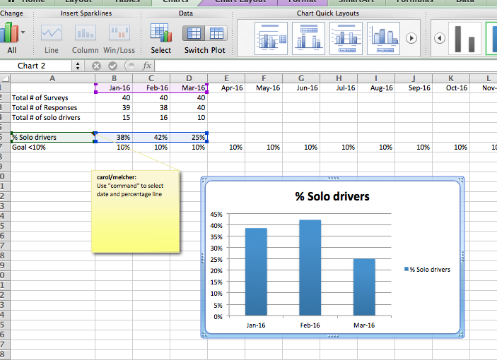

Slide 39
Communicating Clearly
Your turn

Slide 40
While I find out how our data looks, I invite you to discuss the following data slides and see what it is telling us.
Notes:
Partner activity.

Slide 41
Notes:
If you need to get a better look at this slide, please move to where you can see it.
Is the data clear? Does it tell you a “story”?

Slide 42
Let’s look at our data

Slide 43
Easiest method: Count your responses
Notes:
Take your stack of surveys, count them and you will have your results. This is helpful if you are wanting to know how many parking places you need, how much you need to budget for flights.
These data are helpful for tracking # of mom’s with sore nipples, number of visits to the follow-up clinic, areas where volume is important will best be described wit real numbers. This method should not be used to show trends.

Slide 44
Percentages
Notes:
You will want to use percent when comparing month to month or aiming for a specific goals like 80% exclusive breastfeeding.

Slide 45
Simplify categories by showing your “targeted responses” versus “other”
Notes:
If we wanted to change this specific behavior, we could track changes over time by comparing the percentages from one Summit to the next. Using travel by car solo as the targeted element and grouping all other travel together. This is what we do when we look at exclusive breastfeeding. We group all other feeding types together and look at breastfeeding percent only.

Slide 46
Using percentages to track change over time
Notes:
The trend becomes clearer when you eliminate all of the other elements and keep it simple

Slide 47
Common Errors

Slide 48
No column titles, % not converted, 5 questions on one graphs.
Notes:
This doesn’t tell a very clear story. Compared to the activity you did, these data are difficult to quickly interpret. I would suggest these be separated and tracked over time like the sample I gave you

Slide 49
Combining # with % on same graph

Slide 50
“Small numbers”
Notes:
Sometimes your monthly totals are too small and you want to combine. This is fine, add your numbers and calculate quarterly or annual percentages from the numbers. Do not average percentages.

Slide 51
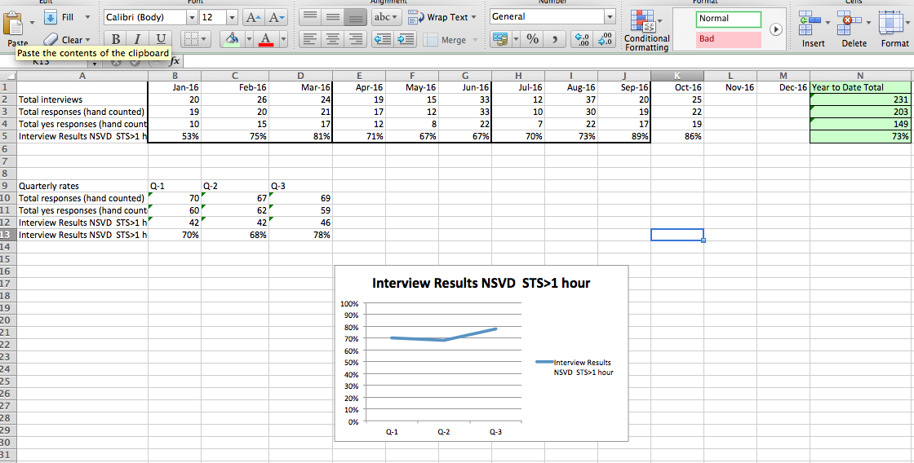
“Small numbers” Combining months
Notes:
Sometimes your monthly totals are too small and you want to combine. This is fine, add your numbers and calculate quarterly or annual percentages from the numbers. Do not average percentages.

Slide 52
Communicating Simply
Your turn

Slide 53
Notes:
Single question, at a given time. Not so great for change over time. No time frame.

Slide 54
What did you think of that sample?
Is the message clear?
Is it missing anything?
How could it be displayed as a trend?
Notes:
Is it getting better or worse, is there a target or goal.

Slide 55
Oops! Remember, we cannot share individual responses, even for fun.
FUN FACT
Who traveled the farthest?

Slide 56
FUN FACT
??? % of the participants in this session were greeted when they arrived.

Slide 57
Use existing data sets when you can
My biggest hint!

Slide 58
Newborn Screening Data
Quick way to plot change over time for one hospital
Same or different from the county of origin
Describe how it is the same or different from California

Slide 59
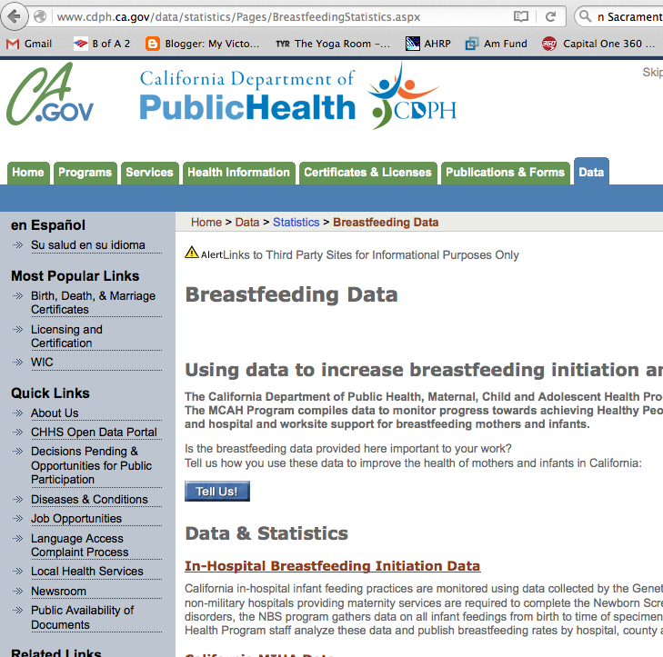
Using Newborn Screening
Locate the data:

Slide 60
Hospital of Occurrence 2014

Slide 61
First page gives California

Slide 62
Counties are listed alphabetically

Slide 63
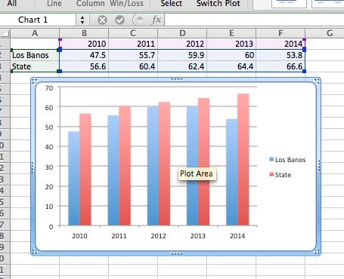
Build your graph in Excel

Slide 64
We can all track something.
As you track variables over time, you are looking for emerging trends.
Data can tell a powerful story.

Slide 65
Thank you

