Slide 1
The Evolution of Birthing Practices
and Its Effects on Breastfeeding
Natalie Johnson BSN, RN, CLE

Slide 3
Objectives
Discuss the typical interventions during labor, delivery and immediate postpartum
Understand the effect these may have on breastfeeding
Become aware of the Mother-Friendly Childbirth Initiative and it’s potential for effecting breastfeeding rates
“Any intervention in birth, no matter how harmless it may seem, may disrupt these precise hormonal shifts and create problems that must be ‘managed’ with medical expertise and equipment.”
-Lamaze International 2005

Slide 4
The River

Slide 5
Brief history of childbirth…
An excerpt from The Way of the Peaceful Birther
1600’s Midwives were provided free housing on the condition she would not refuse when called on. Many midwives were also salaried.
1700’s Upper-class families began to rely on male doctors as primary caregivers
1750-1800’s Physicians did not associate hand washing with infection
1816-The first stethoscope for listening to fetal heart tones was introduced
1848-Dr. Walter Channing of Boston first used ether for childbirth
1853-Queen Victoria of England received chloroform during the birth of her 7th baby, it became a status symbol
1860-Louis Pasteur found bacteria and lack of washing was the major cause of childbed fever (1772- 20% of delivered women contracted this, nearly all of whom died)
1894-The first clinic c-section was performed in Boston

Slide 6
1898-German doctor injected cocaine into his assistant’s spinal column (the forerunner of the modern day epidural). It numbed the fellow’s lower body, but the next morning he woke with horrible vomiting and headaches
1902-1960’s Scopolamine, which causes amnesia, was used during childbirth
1920-The most frequently used obstetric textbook, by Dr. Joseph DeLee, stated that childbirth is a pathological process from which few escape “damage.” In efforts to prevent problems, he proposed that the caregiver employ routine interventions. He suggested that the obstetrician sedate women at the beginning of labor, allow the cervix to dilate, give ether during the pushing stage, cut an episiotomy, deliver the baby with forceps, extract the placenta, give medications for the uterus to contract, and repair the episiotomy.
1933-Maternal mortality rate had not declined between 1915-1930 in spite of women moving childbirth into hospitals1935- 37% of births occur in hospitals
1938-Twilight Sleep used in all hospital births
1939- 50% of all women (75% of all urban women) deliver in hospitals

Slide 7
1940- 95% Twilight Sleep rate. The heavy dose of meds completely incapacitated laboring women and caused them to lose control. Maternal mortality is 47 deaths per 1,000
1950- 88% of births occurred in hospitals
1960- 97% of births occurred in hospitals, continuous electronic fetal monitoring was introduced and used for only “high risk” women
1979- The first studies were conducted on labor anesthesia, including Demerol
1988- 25% c-section rate, patient-controlled epidurals come on the scene
1998- 19.4% induction rate
2002- 26.1% c-section rate, 20.6% induction rate, 85% continuous EFM rate, 91.3% of births occurred in hospitals
2008- 33% c-section rate, The US has some of the worst pregnancy outcomes then almost every other industrialized country, yet provides the world’s most expensive maternity care. 80% epidural rate
2009- ACOG revises EFM guidelines, induction guidelines, and has relaxed their position on women eating and drinking in labor

Slide 8
Where are we today?
What do you see happening in our hospitals?
What was your personal birth experience?

Slide 9
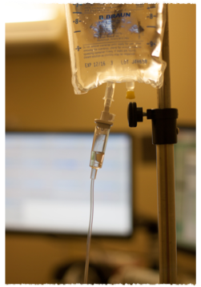
Interventions During Labor
Induction and augmentation
Stripping or sweeping the membranes
Breaking the bag of waters
Prostaglandins
Misoprostol (cytotec)
Oxytocin (Pitocin)
Continuous Fetal Monitoring
IV Fluids
Medications
Epidural
IV medication

Slide 10
Interventions During Birth
Directed breathing and pushing
Assisted Delivery
forceps
Vacuum
Episiotomy
Cesarean Birth

Slide 11
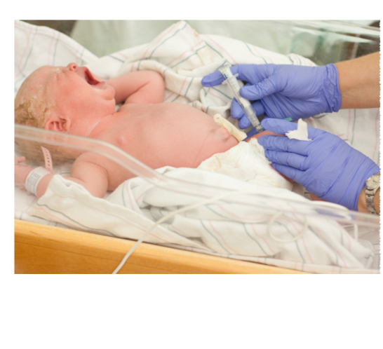
Interventions immediately following birth
Baby
Delay in skin to skin
Vigorous use of bulb syringe
Suctioning
Blood Draw
Postpartum Routines
Baths
Weights
Artificial nipples and use of formula
Separation of mother and baby

Slide 12
Interventions during labor ->
IV fluids
Mom = Slower labor → augmentation → increased pain → increased need for medication
Baby = False high birth weight → increased weight loss → supplementation
Increased discomfort for mom → pain medication → increased stress on baby → more interventions
Decreased mobility →slower labor → augmentation → pain → medication

Slide 13
Medication Use
Increase in other interventions
Increased risk for C/S delivery
Disoriented mom
Sleepy baby→ delay in skin to skin and need for resuscitation
Difficulty with latch, suck, swallow, breath
Women who received > 150 mcg of epidural fentanyl reported breastfeeding problems more often (65%) then those who were given < 150 mcg (35%) of epidural fentanyl.
-Howie & McMullen (2006)

Slide 14
Assisted Delivery
(interventions during birth)
Baby
Forceps → bruising to cranium, jaw deviation, pain
Vacuum → pain → inhibits movement
C/S → separation of mom and baby, increased suctioning, immediate interventions after birth (blood tests, bath, weights)
Mom
Episiotomy → pain → meds → decreased ability to care for newborn
C/S → delayed skin to skin, increased pain during postpartum, delay in milk production

Slide 15
Postpartum interventions
Baby
Delay in skin to skin → respiratory, heart rate, blood sugar, temperature issues → more time away from mom and more interventions
Bulb Syringe → swelling in the nose making it difficult to breath while nursing
Suction equipment → trauma → oral aversion
Blood work → pain → decreased interest in feeding

Slide 16
So what are we doing about it?
What have we already done?
How are you repairing the broken bridge?

Slide 17
Baby-Friendly Hospitals
In 2000 there were ____ Baby-Friendly Hospitals in California.
Today there are ____ Baby-Friendly Hospitals in CA. ____ in the US.

Slide 18
Baby-Friendly Hospitals
2013 Policy Achievements - Healthcare
Gov. Brown has signed SB 402 which requires California hospitals to achieve Baby-Friendly Designation or equivalent by 2025.

Slide 19
Baby-Friendly
The Ten Steps are endorsed and promoted by the major maternal and child health authorities in the United States, including:
American Academy of Family Physicians
American Academy of Nurses
American Academy of Pediatrics
American College of Nurse-Midwives
Academy of Breastfeeding Medicine
Academy of Nutrition and Dietetics
Association of Women's Health, Obstetric and Neonatal Nurses (AWHONN)
Centers for Disease Control and Prevention (CDC)
National WIC Association
U.S. Breastfeeding Committee (USBC)
U.S. Preventive Services Task Force
U.S. Surgeon General

Slide 20
Mother-Friendly Childbirth Initiative (MFCI)
Drafted in 1996, evidence based consensus document
2006 the Coalition for Improving Maternity Services (CIMS) Expert Work Group conducted a systematic review of the evidence
2007 their work confirmed the validity of the MFCI and was published in the Journal of Perinatal Education: Advancing Normal Birth.
The MFCI later served as the basis of the global initiative, the International Mother-Baby Childbirth Initiative (IMBCI) created with technical advisory help from leading national and international organizations including WHO and UNICEF.

Slide 21
MFCI Benefits
Lower rates of maternal and neonatal morbidity and mortality
Higher breastfeeding rates
Increased health benefits for infants
Increased opportunity for matronal-infant attachment
Reduced rate of postpartum complications and re-hospitalization
Higher likelihood of positive mental health and early parenting

Slide 22
Philosophical Cornerstones of the MFCI
Normalcy of the Birthing Process
Empowerment
Autonomy
Do No Harm
Responsibility (accountability)

Slide 23
In 2011 The Journal of Obstetric, Gynecologic, and Newborn Nursing published Quality Patient Care in Labor and Delivery: A Call to Action.
This document, which reflects the philosophical cornerstones of the MFCI, was endorsed by 7 leading US maternity care professional associations…

Slide 24
American College of Obstetricians and Gynecologists
Association of Woman’s Health, Obstetric and Neonatal Nurses (AWHONN)
American College of Nurse Midwives
American Academy of Family Physicians
American Academy of Pediatrics
American College of Osteopathic Obstetricians and Gynecologists
Society for Maternal-Fetal Medicine

Slide 25
Why Do I Care?
This is the other half of the equation.
This is the future of maternity care.
Woman want (and deserve) evidence based practice.
If we start moving this direction, even just one step at a time, we could become leaders in Maternity care.

Slide 26
What can I do?
Look up the Coalition for Improving Maternity Services
FaceBook Page
Website
Look at how you can become a Mother-Friendly care provider.
Learn the 10 steps to becoming Mother-Friendly and spread the word.

Slide 27
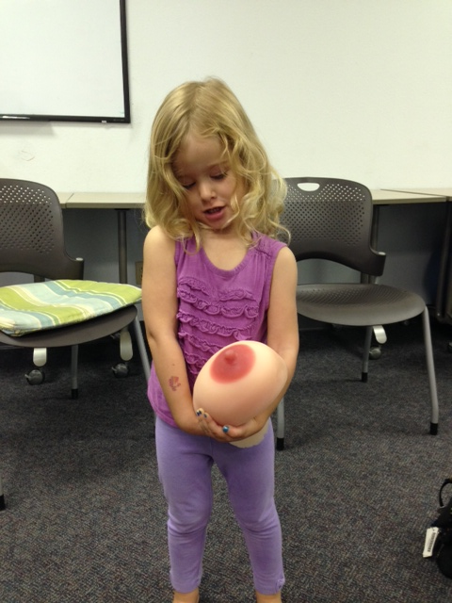
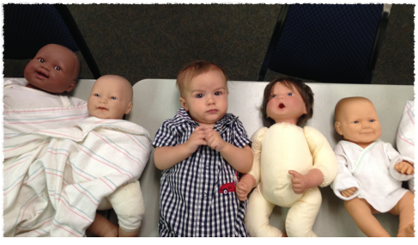
Thank you

Slide 28
References
Goer H. The Thinking Woman’s Guide to a Better Birth. New York: Penguin Putnam, 1999; 64,65,85-98.
Howie W. O., McMullen P. C. Breastfeeding Problems Following Anesthetic Administration. J Perinatal Education (2006).;15(3): 50-57
Kroeger M., Smith L. J. (2004). Impact of birthing practices on breastfeeding: Protecting the mother and baby continuum. Boston: Jones and Bartlett Publishers.
La Leche League. (2009). Childbirth and Breastfeeding Retrieved October 29, 2013, from http://www.llli.org/docs/lad/ChildbirthandBreastfeeding.pdf
Lamaze International. (2005). Introduction to six care practice papers. Retrieved May 12, 2006, from http://www.lamaze.org/institute/carepractices/intro.asp.

Slide 29
What is the Mother-Friendly Childbirth Initiative?
And Why Do I Care?

Slide 30
Baby-Friendly
The 10 Steps to Successful Breastfeeding
1. Have a written breastfeeding policy
2. Train all health care staff in the skills necessary to implement this policy.
3. Inform all pregnant women about the benefits and management of breastfeeding.
4. Help mothers initiate breastfeeding within one hour of birth.
5. Show mothers how to breastfeed and how to maintain lactation, even if they are separated from their infants.

Slide 31
Baby-Friendly
The 10 Steps…
6. Give infants no food or drink other than breast-milk, unless medically indicated.
7. Practice rooming in - allowing mothers and infants to remain together 24 hours a day.
8. Encourage Breastfeeding on demand.
9. Give no pacifiers or artificial nipples to breastfeeding infants.
10. Foster the establishment of breastfeeding support groups and refer mothers to them on discharge from the hospital or birth center.

