Slide 1
SLP’s and IBCLC’s
BreastFriends of the future

Slide 2
Welcome to the Golden Hour!
Today we are going to talk about: Who and what SLP’s do with infants and young children
How they impact breastfeeding for patients
What therapies and assessment they provide that support or require support from SLP’s
IBCLC’s- When to refer to SLP’s
How to support your patients while they are in therapy
How SLP’s can help recognize the origin of and resolve breastfeeding issues
What is needed for ideal collaborations and more wholistic care

Slide 3
Alphabet Soup: SLP vs. IBCLC
Speech-language pathologists (SLP), sometimes called speech therapists, assess, diagnose, treat and help to prevent disorders related to speech, language, cognitive-communication, voice, swallowing and fluency
Notes:
In children ages 0-5 we will concentrate in their roles in evaluating and treating Dysphagia and all other oral-moral reflexes, efficacy of feeding, need for frequency, duration, and method of supplementation, and the relationship of speech acquisition to method and type of feeding in the neonate, infant, and early childhood on both short term and long term outcomes.

Slide 4
ALPHABET SOUP: IBCLC vs. SLP
An International Board Certified Lactation Consultant (IBCLC) is a health care professional who specializes in the clinical management of breastfeeding. IBCLCs are certified by the International Board of Lactation Consultant Examiners, Inc. under the direction of the US National Commission for Certifying Agencies.
Places where IBCLC and SLP naturally and necissarily work together:
Outpatient:
Peds or Allied Health offices
Long-term care of special needs
Inpatient:
NICU
PICU

Slide 5
What does an SLP look for, and How?
Evalutation
Dysphagia
Swallow Studies
GERD and Reflux as related to prematurity
Other co-morbidities or predispositions to abnormal reflexes in swallowing
Assessment:
Lingual and Labial Ankyloglossia
Hazelbaker Assessment for Frenulum Function
Variations on treatment in ULT/PTT
Notes:
Swallow studies in infants:
http://www.ncbi.nlm.nih.gov/pubmed/11436889
Hazelbaker Neonate and Infant guideline
http://www.med.unc.edu/pediatrics/education/current-residents/rotation-information/newborn-nursery/hazelbaker_frenum.pdf

Slide 6
Populations and cohorts:
Though SLP’s, OT’s and PT’s have distinct specializations, they have largely overlapping responsibilities in neonate and infants populations.
NICU:
Significant prematurity (>35 weeks)
Congenital variations
Pierre-Robin’s
Cleft Palate
Nuerologic disorders
Notes:
http://neonataltherapists.com/faq

Slide 7
So what can I do?
How to support our patients using Speech Language Therapists from discharge and beyond

Slide 8
How and When to refer in outpatient
Abnormal Reflexes
Particularly as it relates to persistent disorganization with sucking, swallowing and breathing
Maxofacial anomolies either in appearance or function
Post-revision
Buccal or full ULT/ATT/PTT
Recovery in PR or Cleft Palate
If all of the resources, tools, and evaluation from the IBCLC have been exhausted (or non-conclusive) in the following:

Slide 9
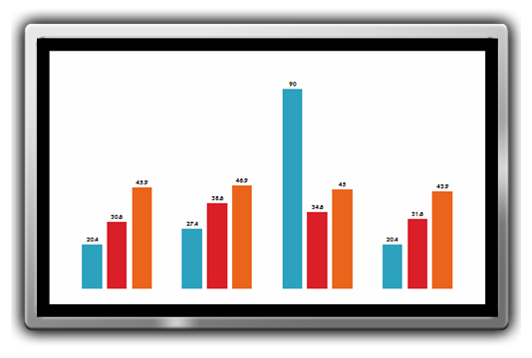
When to refer in outpatient, cont.
Severe GERD
Rule out:
Bovine Protein Intolerance
Any allergies or gastrointestinal irritation due to ingestion sources
Unresolved by pharmacological treatment
If baby has been intubated, always consider consulting.

Slide 10
Widescreen Test Pattern (16:9)
Aspect Ratio Test
(Should appear circular)
4x3
16x9

