Slide 1
Implementation of AB 2507
“Pumping Behind Bars”
Kayellen Young & Susana Berumen-Public Health
Shena Patel, Letisha Stillwell & Maureen Burns-Correctional Health
Lt. Thomas Tanner-Riverside Sheriff Department
January 28, 2020

Slide 2
Objectives
By the end of this presentation you will be able to:
-Discuss the steps for successful implementation of AB2507
-Describe tips for simplifying the policy writing process
-Explain potential challenges
-Demonstrate understanding for the next steps
-Discuss steps that RUHS staff are taking to advocate for incarcerated mothers at the Medical Center

Slide 3
AB 2507 Lactation in the County Jail effective 1-1-20
A county sheriff or the administrator of a county jail to develop and implement an infant and toddler breast milk feeding policy for lactating inmates detained in or sentenced to a county jail and must be posted in the jail and communicated to all faculty.
The policy would include the following provisions:
Procedures for providing medically appropriate support and care related to the cessation of lactation or weaning.
Inmates participation of drug screening
Procedures providing for human milk expression, disposal and same day storage for later retrieval and delivery to an infant or toddler by an approved person.

Slide 4
Working Together
Correctional Health
Public Health-Nutrition
RSO-Riverside Sheriff Office
Mom/Inmate
Families
Behavioral Health
RUHS-Medical Center

Slide 5
Collaboration
1. It helps us problem-solve
2. Collaboration brings people (and organizations) closer together
3. Collaboration helps people learn from each other
4. It opens up new channels for communication
5. Collaboration boosts morale across your organization
6. It leads to higher retention rates
7. Collaboration makes us more efficient workers

Slide 6
Skills Day
Introduction to change
Training w/ Public Health

Slide 7
Staying Connected
Follow up Meetings
Conference Calls
Use of Social Media
Sharing Information/Ideas

Slide 8
Public Health-Nutrition Services
Advisors-Lactation Specific information
Donation of 11 Ameda Electric Breast Pumps
Advise on Purchasing Needs
Trainers

Slide 9
Training
Skills Day-3 ½ days in November for all Correctional Health Staff
Demonstration on the use of the pump
Prevention of engorgement, plugged ducts and mastitis

Slide 10
Referrals
Families to the WIC Program
Loving Support Breastfeeding Helpline
Medications and Mother’s Milk Books or App

Slide 11
Care of the Female Inmate Policy J-103
All female inmates have the right to summon and receive Ob-Gyn services while in custody.
Counseling and assistance are provided in accordance with the pregnant inmate’s expressed desires regarding her pregnancy.
Prenatal care in accordance with national guidelines
Emergency Delivery Kits

Slide 12
RPDC 2019 Pregnancy Tracking Log
77 pregnant inmates booked into facility
7 pregnant inmates admitted to Methadone Clinic
5 inmates gave birth while in custody in 2019
The team identified missed opportunities and need for Lactation program

Slide 13
CHS Lactation Program
Criteria:
Caregiver to pick up milk
Negative HIV and drug test
Agree to random drug test
No medication contraindicate
Agree to pump regularly
Rules:
Milk must be frozen immediately
Clean pump supplies
Designated pumping areas
Upon release breastmilk is picked up w/I 3 days

Slide 14
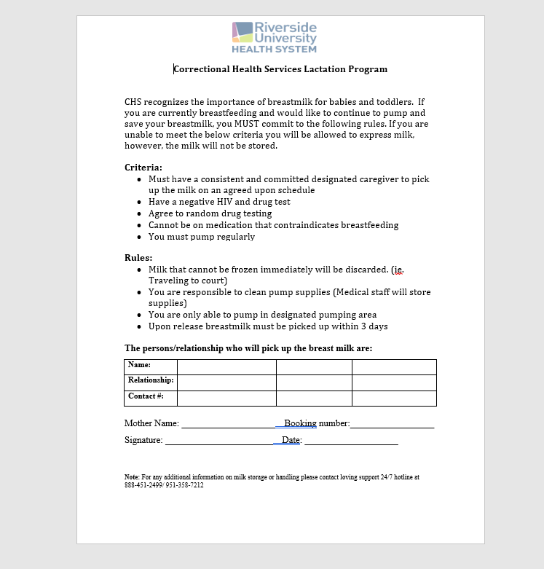

Slide 15
Lactation Program Procedure
Receiving Screening
CHS nurse identify lactating arrestees
Female Intake
Brief review of Lactation Program and support services offered in setting
Drug test and referrals to DBH/Discharge Planning
Nurse Sick Call
CHS nurse reviews program criteria/rules
Provides lactation supplies
Communication with HCP and Sheriff Personal to ensure health care needs or met.

Slide 16
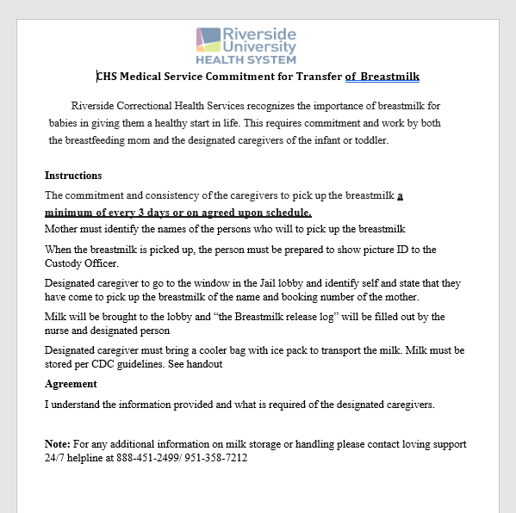

Slide 17
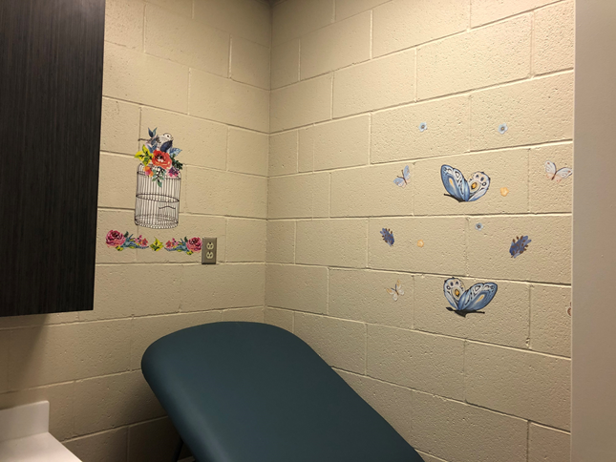
RPDC-Robert Presley Detention Center

Slide 18
RPDC-Lactation Room

Slide 19
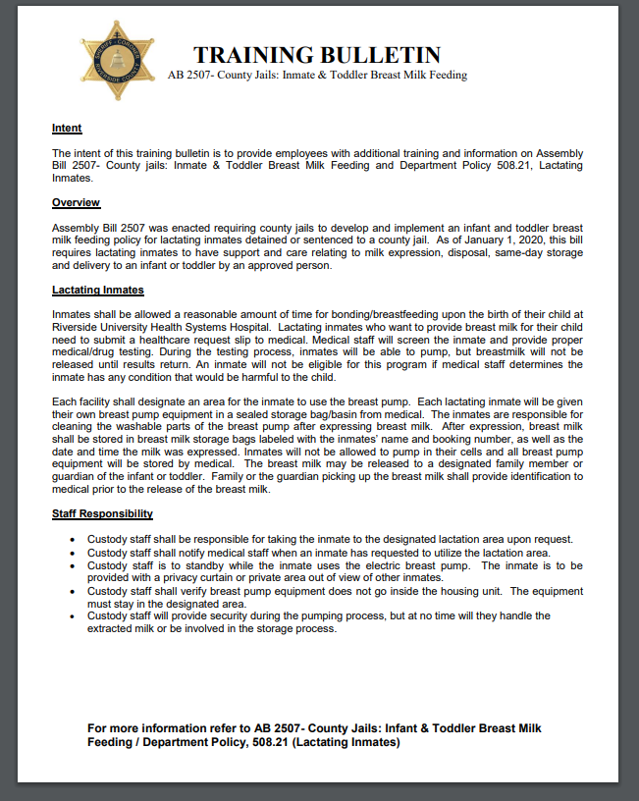

Slide 20
RSD Corrections Division Policy 508.21 – Lactating Inmates
Revised policy published to department personnel
Additional training bulletin published through the department’s “DocRead” internet application.

Slide 21
Corrections Division Policy 508.21 Highlights
Incarcerated mothers who are lactating will be given the opportunity to provide breast milk for their child while in custody.
Initial request to be submitted through medical for initial set-up and screening.

Slide 22
Corrections Staff Responsibility
Upon request, taking the inmate to the designated lactation area.
Notification of medical staff.
Corrections staff to provide security.

Slide 23
Child births while at the Hospital
Expectant mothers
To be allowed a reasonable amount of time for bonding/breastfeeding.

Slide 24
Next Steps
Expand the program to all facilities that house female inmates and juvenile facilities
Continue meeting, with all partner, to monitor the program, making corrections or changes as needed
Identify additional stakeholders- CPS
Make Lactation Program signs for female housing locations/Receiving Screening
Collect data

