Slide 1
Recognizing mental and emotional distress during the postpartum period: What can we do as lactation consultants?
Presented by: Emilia Ortega-Jara, LCSW
Corazon Counseling Service

Slide 2
Personal and Professional Experience
Personal Journey though motherhood
Psychotherapist in Private practice- specializing in maternal mental health
Postpartum Support International Coordinator for Riverside County
Member of the Inland Empire Maternal Mental Health Collaborative/chair of the disparities and diversity subcommittee
Cultural arts practitioner Aztec Dancer/ Traditional Mexican Medicine

Slide 3
Presentation Objectives
Participants will be able to identify and understand the signs and symptoms of perinatal mood disorders
Participants will be able to screen and make appropriate referrals
Participants will be able to identify culturally appropriate interventions
Questions?
What would you like to gain out of this presentation?

Slide 4
Why is Maternal Emotional and Mental Wellness So Important?
10-15% of perinatal women meet the diagnostic criteria of one or more depressive, anxiety, OCD, or trauma related disorder. 1 in 7 women
Suicide is the second leading cause of death for women in the postpartum period
Mothers have a direct impact on the mental, emotional, and physical wellbeing of their children
Transgenerational negative impact effecting all aspects our lives/communities
Mothers are the givers of life, they are the ones who keep the stories, prayers, ceremonies,……..

Slide 5
Lactation and birth workers are key to mothers emotional wellness
Lactation Consultants/Birth workers have direct contact with mothers during the most high risk time frame/onset of symptoms
Have established trust and rapport with families
Have access to knowledge of community resources and referral sources
Help break the silence and stigma
You are an invaluable resource and support!

Slide 6
This is how perinatal mental and emotional distress sounds like……..

Slide 7
Postpartum Blues – is not a mild form of depression
Tearfulness
Predominant happy mood overall
Peaks at 3-5 days after delivery
Present in 50-80% of women in diverse cultures
Due to hormone withdrawal and or effects of maternal bonding hormones

Slide 8
Is it Baby Blues or Postpartum Depression?
Severity- Inability to take care of self or baby/family, worthlessness, hopelessness
Timing- 4 weeks postpartum
Duration - Every day or nearly every day with symptoms

Slide 9
Perinatal Mood and Anxiety Disorders
Depression
Anxiety/Panic Disorder
Obsessive Compulsive Disorder
Bipolar I and Bipolar II
Post-Traumatic Stress Disorder
Psychosis

Slide 10
What are the signs and symptoms?
If a mother tells you that she has not slept in 24 hours
If she has no appetite
Not participating in the care for the baby
Afraid to bathe or carry baby
Not interested in seeing friends or family
Persistent, overwhelming and disruptive concern around baby’s well-being
Perception she is not attached/bonding to baby
Belief baby is better off without her
Compulsive repetitive behaviors (cleaning, counting, checking)

Slide 11
Warning signs continued….
Extreme sadness and hopelessness “ I am doomed, this will never get better, I am a failure”
Intrusive/Scary thoughts/ fear “What if I hurt my baby?”
Anger, irritability and Rage, resentment towards baby and partner
Wanting to run away “I just want to leave”
Feelings of extreme guilt/shame “ I am such a bad mother for having these thoughts and feelings”
Unexplained physical complaints stomach, head and body aches, shakiness
Panic attacks

Slide 12
Perinatal Mood and Anxiety Disorders
1. Depression
Most are undetected and under treated
Depression comorbid with Anxiety
Very treatable and manageable with appropriate interventions
Bipolar Disorders (I & II)
Alternating periods of depression and elevated mood (mania)
60% of women present initially as depressed and are not tx for their condition which makes their mania worse (medication)
50% of women with bipolar are 1st diagnosed in the postpartum period
Bipolar Disorder is chronic, high rates of relapse, suicide, psychosocial dysfunction

Slide 13
Perinatal Mood and Anxiety Disorders
3. Anxiety/Panic Disorder
Most common manifestation of PMAD (restlessness, agitation, irritability, excessive worry/fear)
Panic @ night time usually fear of dying, fear of going crazy, fear of losing control
4. Obsessive Compulsive Disorder
Often occurs along with depression (women ashamed of sharing)
Intrusive, repetitive thoughts- usually of harm coming to baby
Compulsive behaviors such as cleaning, counting, praying

Slide 14
Important difference between OCD and Psychosis
Hypervigilance/ tremendous guilt and shame/ moms aware of thoughts
Mother has no delusions or hallucinations related to harming baby
5. Postpartum Psychosis 1 in 1,000 cases
The most serious of all PMADS requires immediate attention and intervention
Severe mood swings- alternating mania and depression
Confusion, disorientation, insomnia, delusions and hallucinations
- Baby is possessed by demon/ seeing someone else's face instead of baby face
Mother loses touch with reality, thoughts of suicide or homicide
Women do not recognize thoughts/behaviors are unhealthy

Slide 15
Birth Trauma

Slide 16
Why does it happen?
Physiology
Psychological
Social/cultural
Environmental

Slide 17
Entering Motherhood
Myths of motherhood/Super woman syndrome
Perfectionism
Dreams/expectations
Family/cultural expectations
Media images/stories
Pure happiness and joy
Labor orgasmic experience/Motherhood is beautiful…. always

Slide 18
Reality of Motherhood
Physiological, psychological and social changes are inevitable
Hormonal, fatigue, physical healing from labor and delivery
Feelings of loss: identity, control, body image, self esteem, financial, freedom, relationships, career opportunities
Relationship difficulties with partner

Slide 19
Who is at risk?
History of depression/anxiety/bipolar (family)
Significant mood reactions to hormonal changes (puberty, PMS, birth control, pregnancy loss)
Endocrine Dysfunction (thyroid, diabetes)
Social Factors- inadequate social supports, women of color, low SES

Slide 20
Exacerbating factors
Complications in pregnancy and or birth
Traumatic birth experience
Difficulty breastfeeding
High risk pregnancy/infertility problems
NICU baby
Losses-miscarriage, neonatal death, stillborn
History of childhood sexual abuse
Mother/daughter issues
Superwoman Syndrome (perfectionist, high expectations, type A personality)

Slide 21
What’s keeping women from seeking help?
Stigma/shame
Societal/cultural pressures
Lack of awareness, education, and support
Fear their children might be taken away

Slide 22
Perinatal Mood/Anxiety Disorders and Breastfeeding
Women should make an informed decision regarding their breastfeeding options
Expose baby to medication through breast milk
Expose baby to adverse effects of untreated depression/anxiety in the mother
Take medications and wean from breastfeeding the baby
PMADS may worsen with weaning
There are several medications for PMADS that are safe to use while breastfeeding

Slide 23
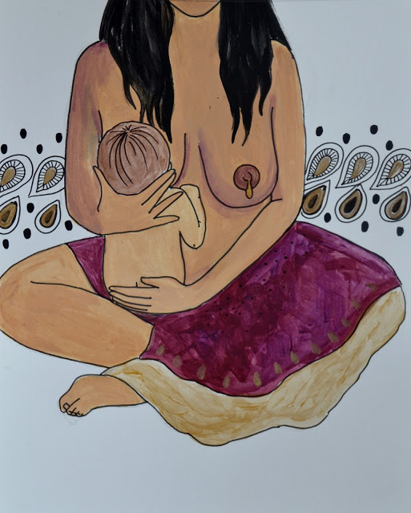
Breastfeeding and Perinatal Mood/Anxiety Disorders
It may be the only thing she feels good about
One should be sensitive and nonjudgmental with her decision to wean or continue breastfeeding
Providing support, info, and encouragement to nurse is half of clinicians responsibility
“Letting women know that they have the right to choose not to breast-feed without guilt or judgment is the other equally important half”
-Beck CT, Wilson, S. Nursing Research, July-August 2008

Slide 24
What does research say about PMADS and Breastfeeding
Numerous studies on the topic have come to contrasting conclusions: There are complex physiological, psychological, and sociocultural mechanisms at play.
Does breastfeeding exacerbate depression?
Depressed mothers negative cognitions reinforce perceived breastfeeding difficulties
“ Failure to breastfeed” Women intended to breastfeed but for various reasons are not able to
Pressure that breast is best
Birth trauma/past sexual trauma
Breastfeeding difficulties, pain, and lack of confidence
Lack of support/pressure from society and family
Pope (2016)

Slide 25
What does research say about PMADS and Breastfeeding?
Emerging research suggests that breastfeeding may offer protective benefits against postpartum depression
“Relationship may be bidirectional in nature, suggesting that while postpartum depression may reduce rates of breastfeeding, not engaging in breastfeeding may increase the risk of postpartum depression. Additionally, there is some evidence that breastfeeding may protect against postpartum depression or assist in a swifter recovery from symptoms.”
Pope (2016)

Slide 26
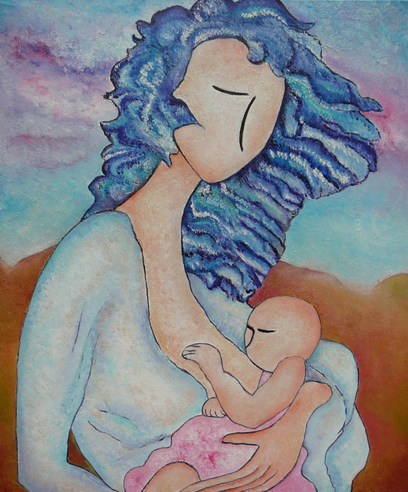
What does research say about PMADS and Breastfeeding?
Hormonal processes(prolactin and oxytocin) help reduce stress
Regulating sleep for mother and child
Increasing mother’s self efficacy and emotional connection to baby
Reducing difficulties related to child temperament
Promoting better mother-infant interaction
Kendall-Tacket (2017)

Slide 27
Clinical Implications for Lactation Consultants
Depression is a major risk factor for breastfeeding cessation, lactation specialist should screen for it.
Maternal stress and fatigue reduce prolactin levels, and may lead to breastfeeding cessation. High levels of cortisol can delay lactogenesis II.
Breastfeeding difficulties, especially nipple pain, can lead to depression and need to be addressed promptly
Kendall-Tacket (2017)

Slide 28
What can we do?
First, examine own beliefs, biases, and values around mothering and postpartum
Begin the conversation/ask questions from a very non judgmental stance
“ I’m concerned about how little sleep you are getting”
“ I’ve noticed you are not interested in eating”
“I’ve noticed you have not left the house with the baby”
You don’t need to be a mental health professional to provide support
Let them know: they are not alone, they are not to blame and with the right help they will get better!

Slide 29
What can we do?
Assess safety- “do you feel safe with yourself and your baby?”
Screen mothers with tools accessible to you, such as Edinburg, PHQ 9
Begin to build your own referral base to know where to refer mothers if they score high on the scale or if you suspect she might need more support.
Develop a postpartum wellness plan with parents (pass out tips)
Get involved in starting a support group
Policy and legislative work

Slide 30
Screening- What is recommended?
Mandatory depression screening of pregnant and postpartum women is now recommended American College of Obstetrics and Gynecology, the American Academy of Pediatrics and the American Medical Association, following the 2016 recommendation from the United States Preventive Services Task Force (2016).
First prenatal visit
At least once in second trimester
At least once in third trimester
Six-week postpartum obstetrical visit (or at first postpartum visit)
Repeated screening at 6 and/or 12 months in OB and primary care settings
3, 9, and 12 month pediatric visits

Slide 31
Screening Tools
Screening tools:
PHQ 9 (Patient Health Questionnaire-9)
EPDS (Edinburgh Postnatal Depression Scale)
Recommended cut-off score for a positive screen using either tool is 10.
Have a Screening and follow up procedure in place to know appropriate next steps
Staff training on how to respond appropriately (postpartum stress center)

Slide 32
Screening, What can we do?
Intervene early- determine whether hospitalization is required
Contact family members, if indicated, in her presence
Refer rapidly (Develop comprehensive referral base)
Follow up, follow up, follow up!
Mobilize support: family, community, professionals

Slide 33
Biopsychosocial approach to treatment
Biological
Psychotropic medications
Complementary Alternative Medicine (Traditional Chinese Medicine and Traditional Mexican Medicine)
Psychological
Individual therapy (Interpersonal, CBT)
Family/Couples therapy
Social
Support groups

Slide 34
Vignettes discussion
34 year old Latina professional first time mother calls you crying that she is having a difficult time breastfeeding. In her conversation with you she states “ I can’t do this, it’s so hard, I am failing, I am such a bad mother, I feel I can’t do anything right with this baby, I should have never been a mother.
21 year old with hx of sexual abuse recently gave birth at hospital is having difficulty bonding with baby and has little interest in breastfeeding her newborn.
26 year old is always at breastfeeding clinic calls your regularly to get reassurance that baby is okay, she tells you she can’t sleep and is feeling very scared having thoughts that baby is going to die if she does not produce enough milk, she has dreams and thoughts that baby starves to death, she is also constantly checking up on baby .

Slide 35
Resources
Inland Empire Maternal Mental Health Collaborative www.iemmhc.org
Postpartum Support International www.postpartum.net 800- 944-4773
Maternal Mental Health Now www.maternalmentalhealthnow.org
Free app Bringing light into motherhood for mamas a Community Provider Toolkit
Breastfeeding:
www.infantrisk.com
www.mothertobaby.org 866-626-6847
www.neonatal.ttuhsc.edu/lact
www.motherisk.org
Thomas Hale, PhD- “Medication and Mothers Milk”

Slide 36
Corazon Counseling Service Faciliating Womens Emotional Wellness from Puberty to Motherhood
Emilia Ortega-Jara, LCSW
Individual and Family Psychotherapy
Rites of passage ceremonies/Indigenous Wellness
Consultation and trainings on Latino Mental health/Maternal Mental health
Office Phone-
Email: therapy@corazoncounseling.com
Website: www.corazoncounseling.com
Facebook: Corazon Counseling

Slide 37
References
Carley J. Pope and Dwight Mazmanian, “Breastfeeding and Postpartum Depression: An Overview and Methodological Recommendations for Future Research,” Depression Research and Treatment, vol. 2016
Kendall-Tacket, K (2017) Depression in New Mothers, Causes, Consequences, and Treatment Alternatives. New York, NY: Routledge
BRINGING LIGHT TO MOTHERHOOD Perinatal Mental Health Community Provider Toolkit Third Edition Created by Maternal Mental Health Now (2017)
Postpartum Support International Components of Care Training Manual (2009)
Wisner KL, Sit DKY, McShea MC, Rizzo DM, Zoretich RA, Hughes CL, Eng HF, Luther JF, Wisniewski SR, Costantino ML, Confer AL, Moses-Kolko EL, Famy CS, Hanusa BH. Onset Timing, Thoughts of Self-harm, and Diagnoses in Postpartum Women With Screen-Positive Depression Findings. JAMA Psychiatry.2013;70(5):490–498. doi:10.1001/jamapsychiatry.2013.87
Art by: Spirit y Sol and Tamara Adams

