Slide 1
The Next Generation of Baby-Friendly
February 25, 2020
Trish MacEnroe, BS, CDN, CLC

Slide 2
Speaker Disclosures
The speaker discloses employment with Baby-Friendly USA, Inc.
There are no other conflicts of interest
This presentation is not supported by any funds from companies that violate the International Code of Marketing of Breastmilk Substitutes

Slide 3
Objectives
Learners will be able to
Describe the purpose of the two key WHO/UNICEF documents: Protecting Promoting and Supporting Breastfeeding in Facilities Providing Maternity and Newborn Services Guideline and Implementation Guidance
Describe critical changes found in the Interim GEC to Steps 7 and 9
Describe the US BFHI plans for the future

Slide 4
US Data
604 Designated Facilities
433 working towards designation
257 facilities in the Discovery Phase
18 facilities in the Development Phase
68 facilities in the Dissemination Phase
90 facilities in the Designation Phase
1,101,500 births 28.57% of US births
~2700 total birthing facilities in US

Slide 5
California Data
95 Designated Facilities
178,495 births
4.6% of US births
32 working towards designation
19 facilities in the Discovery Phase
1 facilities in the Development Phase
5 facilities in the Dissemination Phase
7 facilities in the Designation Phase

Slide 6
Country | # Births in Country | % Births in BFHI Facilities | # Births in BFHI Facilities
France | 800,000 | 5.0% | 40,000
Germany | 715,000 | 19.6% | 140,000
Italy | 488,000 | 5.7% | 27,816
Japan | 1,004,250 | 4.0% | 40,170
New Zealand | 61,000 | 96.5% | 58,865
Russia | 1,800,000 | 21.0% | 378,000
Spain | 419,000 | 4.5% | 18,855
US | 3,855,500 | 28.57% | 1,101,500

Slide 7
New BFHI Implementation Guidance

Slide 8
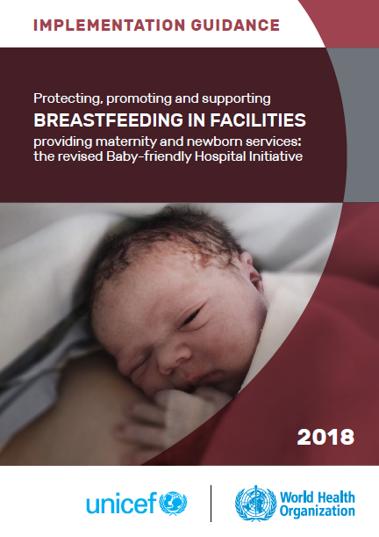
2018 BFHI Implementation Guidance

Slide 9
GOAL of Updated BFHI Implementation Guidance
Reinvigorate the BFHI
Encourage wider spread adoption of practices to support breastfeeding
Set attainable goals for countries who have very low adoption of the practices
Calls for a scaling up of the BFHI to 100% coverage

Slide 10
Protecting, Promoting and Supporting Breastfeeding in Facilities Providing Maternity and Newborn Services - The Difference between the Guideline and Implementation Guidance

Slide 11
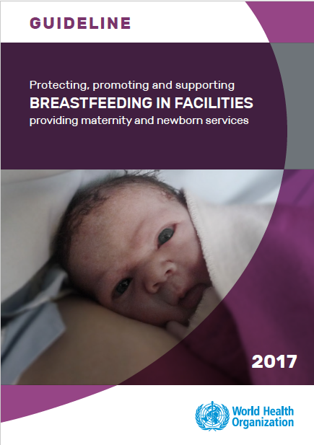
Overview of WHO Guidance
2 related documents

Slide 12
2017 Guideline

Slide 13
WHO Guideline
For WHO purposes:
a “Guideline” is a document that contains a WHO health recommendation about a health intervention
WHO issues both clinical and public health/public policy guidelines
Implementation guides are NOT guidelines

Slide 14
2018 BFHI Implementation Guidance

Slide 15
2018 BFHI Implementation Guidance
WHO considers “implementation guidance” to be a strategy and/or series of strategies that may be utilized to implement a recommendation about a health intervention

Slide 16
What is the process for updating the Guidelines and Evaluation Criteria for the US?

Slide 17
US Process for Updating Guidelines
Developed a crosswalk between BFUSA 2016 GEC and WHO 2018 Implementation Guidance
May 2018
Identified new standards to be immediately implemented
June 2018
Rolled out 2016 GEC v2 with adjustments to Step 9
July 2018
Convened Expert Panel
July 2018

Slide 18
US Process for Updating Guidelines
Revised Guidelines and Evaluation Criteria based on WHO 2018 materials
First draft
Prepared by BFUSA Clinical Director
December 2018
Review draft
Clinical Committee/ Expert Panel
February 2019
Second draft
BFUSA Clinical Team
April 2019

Slide 19
US Process for Updating Guidelines
Requested feedback and comments from 7 National Professional Medical Associations
Comments due by July 12
Second Expert Meeting
Clinical Committee/ Expert Panel
July 22/23 2019
Interim GEC Document
December 9, 2020
Final Document to align with WHO 2018 (Pending agreement with WHO on training and competencies)
2nd Quarter 2020???

Slide 20
Working Cover

Slide 21
Key Content and Format
Introduction
Brief history of the BFHI
Background on the WHO revision process
Background on the BFUSA revision process
Components of each step
Discussion of the Ten Step revision process including chart comparing the revised 2018 Ten Steps to the original version
Importance of breastfeeding
Section on culture and equity

Slide 22
Key Content and Format
Steps
Step number, name and infographic – identical to WHO/UNICEF
Rationale - mostly WHO/UNICEF some US clarification
Implementation Guidance - mostly WHO/UNICEF with US clarification

Slide 23
Key Content and Format
Steps
Considerations for Safe Implementation of Practice – US additions based on government and/ professional medical association clinical recommendations and policy documents
Standards - - mostly WHO/UNICEF some US clarification (WHO percentages were removed and incorporated into Criteria for Evaluation)

Slide 24
Key Content and Format
Steps
Criteria for Evaluation – US designed based on statements in Implementation Guidance and Global Standards
Additional Resources - US additions based on government and/professional medical association materials and resources (no proprietary resources were included)

Slide 25
Key Content and Format
Appendices
Patient Education Topics
Indicators For Facility Monitoring of Key Clinical Practices
Competency Skills List
Affiliated Prenatal Services Questionnaire
Acceptable Medical Reasons For Breast Milk Substitutes
Definitions of Terms and Abbreviations
Expert Panel Members
GEC Clarification Statements
References

Slide 26
Key Challenge
Some of the new steps have more stringent criteria (Step 2) and will take a longer time to implement
Some of the new steps will have more flexible criteria and there is an expectation they will be immediately implemented.
Can one document do both?

Slide 27
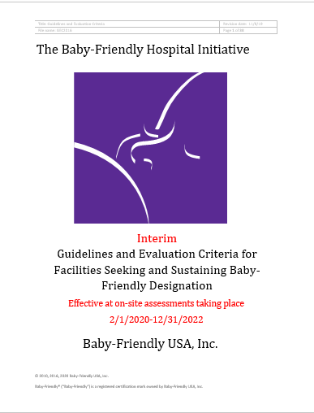
Resolution

Slide 28
Summary of changes in Interim GEC – Continue to use the Original Ten Steps

Slide 29
Step 2 – Staff Training
Page 11 - ADDED THE WORDS “completion of”
2.1.3 Criterion for evaluation: The designated health care professional(s) will provide documentation that training for breastfeeding and parent teaching for formula preparation and feeding is provided for all health care staff caring for mothers, infants and/or young children and that new staff are oriented on arrival and scheduled for the completion of training within 6 months (for example, by providing a list of new staff who are scheduled for training).

Slide 30
Rationale
Provides clarification that all policy orientation and new staff training are to be completed by 6 months after hire date.

Slide 31
Step 3 – Prenatal Education
Page 13 REMOVED
3.2.2 Criterion for evaluation: Of the randomly selected pregnant women in the third trimester who are using the facility prenatal services, at least 80% will confirm that a staff member has talked with them or offered a group talk that includes information on breastfeeding.

Slide 32
Step 3 – Prenatal Education
Page 13 REPLACED WITH NEW
3.2.2 Criterion for evaluation: At least 80% of pregnant women will report that a staff member at the affiliated prenatal services entered into a conversation with them on the necessary topics, either one-on-one or in small groups, or by following up to education provided through another learning mode [videos, podcasts, texts] based on their specific needs.

Slide 33
Rationale
Technology is considered a viable mechanism for providing education on various topics.
The WHO Guidance stresses the importance of conversations about breastfeeding with mothers and families to clarify questions and address concerns.
The revised criterion addresses both issues.

Slide 34
Step 5 – Help with infant feeding
Page 18 ADDED REFERENCE TO UPDATED SAFE FORMULA PREPARATION GUIDANCE
5.3 Guideline: Mothers who feed formula should receive written instruction, not specific to a particular brand, and verbal information about safe preparation, handling, storage, and feeding of infant formula (See Appendix D - Formula: Safe Preparation, Storage and Feeding). Staff should document completion of formula preparation instruction and safe feeding in the medical record. This information should be given on an individual basis only to women who are feeding formula or mixed feeding their infants.

Slide 35
Appendix D – Safe Formula Prep
Page 34 - Safe preparation, feeding, and storage of formula instruction must follow the recommendations of leading national or international authorities and must include:
appropriate hand hygiene
cleaning infant feeding items [bottles, nipples, rings, caps, syringes, cups, spoons, etc.] and workspace surfaces
appropriate and safe reconstitution of concentrated and powdered infant formulas
accuracy of measurement of ingredients

Slide 36
Appendix D – Safe Formula Prep
Continued
5. safe handling of formula
6. proper storage of formula
7. appropriate feeding methods which may include feeding on cue, frequent low volume feeds, paced bottle techniques, eye-to-eye contact, and holding the infant closely
8. powdered infant formula is not sterile and may contain pathogens that can cause serious illness in infants younger than 3 months

Slide 37
Appendix D – Safe Formula Prep
National and international authorities include:
American Academy of Pediatrics
Centers for Disease Control and Prevention
Food and Drug Administration
United States Department of Agriculture
World Health Organization

Slide 38
Step 5 – Help with infant feeding
IMPACTS THE ASSESSMENT OF
5.3.1 Criterion for evaluation: Of maternity staff members, at least 80% can describe how mothers who are feeding formula can be assisted to safely prepare and feed formula to their infants.
5.3.3 Criterion for evaluation: Of mothers who are feeding formula, at least 80% will report that they have been provided education about preparing and giving their infants feeds and can describe the advice they were given.
We will look for education on powdered infant formula not being sterile

Slide 39
Rationale
Aligns with the recommendations of the majority of federal agencies
Aligns with AAP recommendations

Slide 40
Step 7 – Rooming In
Page 19 - REMOVED LANGUAGE
7.1 Guideline: … When a mother requests that her infant be cared for in the nursery, the health care staff should explore the reasons for the request and should encourage and educate the mother about the advantages of having her infant stay with her in the same room 24 hours a day. If the mother still requests that the infant be cared for in the nursery, the process and informed decision should be documented. …

Slide 41
Step 7 – Rooming In
Page 19 - REPLACED WITH NEW
7.1 Guideline: … When a mother requests that her infant be cared for in the nursery, the health care staff should sensitively engage her in a conversation to learn more about the reasons for the request. Considering the importance of rooming-in, staff should work to resolve any medical reasons, safety-related reasons, or maternal concerns…

Slide 42
Step 7 – Rooming In
Page 19 - REPLACED WITH NEW
7.1 Guideline: … If there is separation, the mother should be provided:
access to feed her infant at any time and
with a plan that she will be reunited with her infant as soon as her infant displays feeding cues.

Slide 43
Rationale
Encourages conversation between hospital staff and mother.
It is intended to sound less authoritative.

Slide 44
Step 7 – Rooming In
Page 20 - ADDED REASONS FOR SEPERATION
7.1.2 Criterion for evaluation: Of randomly selected mothers with healthy term infants, at least 80% will report that since they came to their room after birth (or since they were able to respond to their infants in the case of cesarean birth), their infants have stayed with them in the same room day and night except for up to one hour per 24-hour period, unless they report the following:
- medically justifiable reason for a longer separation or,
safety-related reason for a longer separation or,
an informed decision (maternal request for separation).

Slide 45
Step 7 – Rooming In
Page 20 - ADDED NEW CRITERION
7.1.3 Criterion for evaluation: Of mothers and infants who have been separated for more than a total of one hour in a 24-hour period, at least 80% will have the justifiable or safety related reasons for the separation, evidence of parental counseling (in the event of parental choice) clearly documented in the medical record.
NOTE: Former criteria 7.1.3 has been renumbered to 7.1.4

Slide 46
Step 7 – Rooming In
LANGUAGE WAS ADJUSTED
7.1.4 Criterion for evaluation: Observations in the postpartum unit and any well-baby observation areas and discussions with mothers and staff confirm that at least 80% of the mothers and infants are rooming-in or have documented medically justifiable reasons, safety-related reasons, or informed maternal decision for separation.

Slide 47
Rationale
Guides staff in BFHI designated facilities to use clinical judgement specially as it relates to rooming in.
Responds to the concerns raised by some mothers.
Requires documentation of reasons for separation.

Slide 48
Step 9 – Bottles, nipples & pacifiers
Page 21 - ADDED LANGUAGE UNDER THE STEP TITLE
This Step is now interpreted as:
Counsel mothers on the use and risks of feeding bottle, teats and pacifiers.

Slide 49
Step 9 – Bottles, nipples & pacifiers
Page 20 – REMOVED LANGUAGE
9.1 Guideline: When a mother requests that her breastfeeding infant be given a bottle, the health care staff should explore the reasons for this request, address the concerns raised, educate her on the possible consequences to the success of breastfeeding, and discuss alternative methods for soothing and feeding her infant.

Slide 50
Step 9 – Bottles, nipples & pacifiers
Page 20 – REPLACED WITH
9.1 Guideline: …When a mother requests that her breastfeeding infant be given a bottle, the health care staff should engage in a conversation about the reasons for this request, address the concerns raised, educate her on the possible consequences to the success of breastfeeding, and discuss alternative methods for soothing and feeding her infant…

Slide 51
Step 9 – Bottles, nipples & pacifiers
Page 21 - REMOVED:
9.1.1 Criterion for evaluation: Of breastfeeding mothers, at least 80% will report that:
to the best of their knowledge, their infants have not been fed using bottles, or
if they are using bottles, bottle use was requested after receipt of appropriate education and counseling from staff

Slide 52
Step 9 – Bottles, nipples & pacifiers
Page 21 - REPLACED WITH NEW:
9.1.1 Criterion for evaluation: At least 80% of breastfeeding mothers that are unable to feed their baby directly at the breast or needed/chose additional supplementation will report:
A. Alternative feeding methods were offered and
B. If requesting bottles, mothers can describe one possible impact that bottles and artificial nipples might have on breastfeeding.

Slide 53
Step 9 – Bottles, nipples & pacifiers
REMOVED – NO REPLACEMENT
9.1.2 Criterion for evaluation: Observations in the postpartum unit and any well-baby observation areas will indicate that at least 80% of breastfeeding infants are not using bottles, or, if they are, their mothers have been informed of the risks and this education is documented in the medical record.
NOTE: Former criteria 9.1.3 has been renumbered to 9.1.2

Slide 54
Step 9 – Bottles, nipples & pacifiers
REMOVED LANGUAGE
9.2 Guideline: …When a mother requests that her breastfeeding infant be given a pacifier, the health care staff should explore the reasons for this request…

Slide 55
Step 9 – Bottles, nipples & pacifiers
REPLACED WITH
9.2 Guideline: …When a mother requests that her breastfeeding infant be given a pacifier, the health care staff should engage in a conversation about the reasons for this request…

Slide 56
Step 9 – Bottles, nipples & pacifiers
Page 22 - REMOVED
9.2.1 Criterion for evaluation: Of breastfeeding mothers, at least 80% will report that:
to the best of their knowledge, their infants have not sucked on pacifiers, or
that pacifier use was limited to painful procedures, or
that pacifier use was chosen by the infant’s parents after receipt of appropriate education and counseling from staff.

Slide 57
Step 9 – Bottles, nipples & pacifiers
Page 22 - REPLACED WITH NEW
9.2.1 Criterion for evaluation: At least 80% of breastfeeding mothers can describe one possible impact that pacifiers might have on breastfeeding.

Slide 58
Step 9 – Bottles, nipples & pacifiers
Page 22 - REMOVED – NO REPLACEMENT
9.2.2 Criterion for evaluation: Observations in the postpartum unit and any well-baby observation areas will indicate that at least 80% of breastfeeding infants are not using pacifiers, or, if they are, their mothers have been informed of the risks and this education is documented in the medical record.

Slide 59
Step 9 – Bottles, nipples & pacifiers
Page 22 - ADDED
9.2.2 Quality Improvement Criterion – not for designation: At least 80% of breastfeeding mothers can describe what the appropriate time is for introducing the pacifier.

Slide 60
Step 9 – Bottles, nipples & pacifiers
Page 22 - ADDED
9.2.3 Quality Improvement Criterion – not for designation: At least 80% of health care professionals can describe when the appropriate time is for introducing the pacifier.

Slide 61
Step 9 – Bottles, nipples & pacifiers
RENUMBERED FORMER 9.2.3 to 9.2.4

Slide 62
Step 9 – Bottles, nipples & pacifiers
RATIONALE
More flexible than our current Step 9 Criteria for Evaluation.
Aligns with the 2018 WHO Implementation Guidance.

Slide 63
International Code
ADDED Reference to updated Safe Sleep Guidance
Criterion for evaluation: Observations in the antenatal and maternity services and other areas where nutritionists and dietitians work indicate that no materials that promote breast milk substitutes, bottles, nipples, pacifiers * or other infant feeding supplies are displayed or distributed to mothers, pregnant women, or staff. (*See Appendix D: Exclusive Breastfeeding, Pacifiers, and Safe Sleep)

Slide 64
International Code
RATIONALE
Supports breastfeeding and SIDS reduction messages.
Aligns with the more flexible language for Step 9 of 2018 WHO Implementation Guidance.

Slide 65
What is next?

Slide 66
Finalize 2023 GEC

Slide 67
Adopt the Revised 10 Steps

Slide 68
The Ten Steps to Successful Breastfeeding
2018 Revised | Original
1 A. Comply fully with the International Code of Marketing of Breast-milk Substitutes and relevant World Health Assembly resolutions. 1 B. Have a written infant feeding policy that is routinely communicated to staff and parents. 1 C. Establish ongoing monitoring and data-management systems. | 1. Have a written breastfeeding policy that is routinely communicated to all health care staff.
2. Ensure that staff have sufficient knowledge, competence and skills to support breastfeeding. | 2. Train all health care staff in the skills necessary to implement this policy.

Slide 69
The Ten Steps to Successful Breastfeeding
2018 Revised | Original
3. Discuss the importance and management of breastfeeding with pregnant women and their families. | Inform all pregnant women about the benefits and management of breastfeeding.
4. Facilitate immediate and uninterrupted skin-to-skin contact and support mothers to initiate breastfeeding as soon as possible after birth. | 4. Help mothers initiate breastfeeding within one hour of birth.
5. Support mothers to initiate and maintain breastfeeding and manage common difficulties. | 5. Show mothers how to breastfeed and how to maintain lactation even if they are separated from their infants.

Slide 70
The Ten Steps to Successful Breastfeeding
2018 Revised | Original
6. Do not provide breastfed newborns any food or fluids other than breast milk, unless medically indicated. | 6. Give infants no food or drink other than breast-milk, unless medically indicated.
7. Enable mothers and their infants to remain together and to practice rooming-in 24 hours a day. | 7. Practice rooming-in – allow mothers and infants to remain together 24 hours a day.
8. Support mothers to recognize and respond to their infants’ cues for feeding. | 8. Encourage breastfeeding on demand.

Slide 71
The Ten Steps to Successful Breastfeeding
2018 Revised | Original
9. Counsel mothers on the use and risks of feeding bottles, teats and pacifiers. | 9. Give no pacifiers or artificial nipples to breastfeeding infants.
10. Coordinate discharge so that parents and their infants have timely access to ongoing support and care. | 10. Foster the establishment of breastfeeding support groups and refer mothers to them on discharge from the hospital or birth center.
 | Comply with the International Code of Marketing of Breast-milk Substitutes.

Slide 72
Helpful Resources

Slide 73
Step 1 - ABM Model Hospital Policy
https://www.bfmed.org/assets/7%20ABM%20Model%20Maternity%20Policy%20Supportive%20of%20Breastfeeding%20English.pdf

Slide 74
ABM Model Hospital Policy
Current – released in November 2018
Evidence based – 194 References
Comprehensive – addresses all Ten Steps
Offers guidance on safe implementation of practice

Slide 75
Steps 4 & 7
Lori Feldman-Winter, Jay P. Goldsmith, Safe Sleep and Skin-to-Skin Care in the Neonatal Period for Healthy Term, Pediatrics 2016;138;, originally published online August 22, 2016;

Slide 76
Roll-out date for 2023 GEC
Still to be decided
Will be announced via Constant Contact
Notices will be placed on the portal

Slide 77
A million thanks…from the more than a million mothers and babies whose care you helped improve

