Slide 1
Herbal Allies for the Breastfeeding Mother
Instructor: Bethany Ewers CD, CLC
Birth By The Sea ~ 714-612-1126 ~ www.birthbythesea.com

Slide 2
Overview…
Herbal Energetics- how herbs are used in Western, Aruveydic, and Chinese Medicine. The energetics of pregnancy and postpartum.
Treatment Modalities: Types of preparations and the scale of potency.
Herbs for increasing milk supply
1: Herbs that work by affecting digestion and supporting the liver or kidney.
2: Herbs that affect hormone balance in the body.
3: Herbs whose primary role is as a nutritive or trophorestorative.
Herbs for down regulating milk supply and herbs to avoid.
Deciding how to approach a low supply with a mother.
Herbs for other breastfeeding issues. Engorgement, Mastitis, Clogged ducts, Allergies, Cold and Flu, Menstrual Cycle.
Resources.

Slide 3
An brief introduction to energetics.
“In herbalism we do not use the ‘active ingredient’ but the combination presented by nature. We use a ‘slurry’ of constituents which, altogether, nudge the organism in a certain direction. The power of the herb is not based on the sheer force of the radical active ingredient, as in biomedicine, but on the cumulative power of a bunch of little ‘nudges’ all operating in a certain direction, i.e., on a physiological mechanism in the organism which is itself the product of a ‘slurry’ of biochemical processes and changes.” – Matthew Wood
The three main energetic systems that govern herbal medicine: Western, Ayurvedic, and Chinese. They all have long traditions of use but the Ayurvedic and Chinese systems have the most written and unbroken history of use. All energetic systems divide the properties of the body and medicine into a range of hot/cold, dry/damp, excitation/stagnation, relaxation/atrophy. In Ayurvedic this looks like the Doshas – or three constitutions. In Chinese Medicine it looks like the five elements – wind, fire, metal, water, and earth combined with the yin and yang energies. In Western Tradition our history used the term ‘humors’. All illness or imbalances are looked at on a scale and then herbs are matched to correct or enhance those tissue states. It looks something like this…

Slide 5
Where do pregnancy and breastfeeding fall on the scale?
Pregnancy in almost all modalities is a warm, high energy, state. Common pregnancy complaints like heartburn are both hot and lax (progesterone relaxes the tissues and slows digestion). In TCM a women is full of chi energy and warm. Our blood volume doubles, our body temperature rises, we sweat more, and we eat more. Our tissues also soften – think relaxin and our digestion slows.
In postpartum the mothers body is in flux. We go from being full of hot chi to being cold – our blood volume decreases, our organs have to return to place, our thyroid has to kick back into gear, our milk has to come in. We have a lot to do to return to homeostasis. In general breastfeeding is a cooler moist and tense state. Oxytocin pulses to release milk, we are moving our lymph and our digestion picks up, we are over tired and emotional.

Slide 6
Types of preparations of herbs.
Herbs can be prepared a number of different ways. The best way to use an herb is a preparation that harmonizes with the active constituents in the herb. For example polysaccharides release best in water, while alkaloids do best in alcohol.
Eat it! The simplest method is to eat herbs or cook them in your food.
Tea – herb extracted in hot or cold water.
Oil – herbs can be extracted into oil to use on the skin. Some herbs require an alcohol intermediary like calendula.
Decoction – herb boiled and steeped in water. I.e.: roots
Syrup – herb boiled and reduced in water and blended with sugar or honey to make a syrup for preservation (half decoction/half sugar)
Acetum – herb extracted in vinegar (especially good for acid loving alkaloids)
Glyceride – herb extracted in to vegetable glycerin (good for water loving plants).
Alcohol extract or Tincture – herb extracted into alcohol. The percentage of alcohol to water varies depending on what properties you are trying to extract.

Slide 7
Difference between Herbs and Homeopathy and Essential Oils
Herbs are, in general, used or extracted from the a single whole part of the plant. For example the seed, the root, the flowering top, or the leaves.
Essential oils: The essential volatile oil portion of the plant – usually aromatic, steam distilled or pressed from the plant, separating it from its other constituents. Requires a LOT of plant material.
Hydrosols: The left over water from steam distilling an essential oil. Contains some essential oil and the other plant constituents left behind. Generally gentler and a good way to use dilute essential oils.
Homeopathy: An alcohol based extract of a plant diluted and succused repeatedly to dilute the original plant matter and concentrate the ‘energy’ of the plant in water. In homeopathy the weaker the remedy the stronger the reaction in the body. Works on the principal of sympathetics. Flower essences fall under this category.

Slide 8
Making More Milk With Herbs
There are three basic categories of herbal actions that galactagogues fall into.
Herbs that affect digestion and support the liver/kidney’s;
Herbs that effect hormone balance.
Herbs that effect nutritional issues – tropho- restoratives and adaptogens
It is important to understand the basic mechanics of milk supply and a mothers history before recommending herbs. During an intake I would look at birth history: Did she have a c-birth or a vaginal birth? Hemorrhage? IGT? History of low supply? Insulin Resistance? Is she sleeping? What were her periods like before baby – PCOS? Is she STRESSED? Is she eating? All of these questions help us to formulate a plan of herbal support and give us an idea of what might work best for her. Not all women respond to all herbs equally!

Slide 9
Digestive Herbs
Fenugreek – Part used: Seed; the number one galactagogue used in the US but not other parts of the world. Affects blood sugar by lowering it in high doses. Used as an appetite stimulant. Generally best made into a tea or tincture. Has a slightly bitter and maple syrup kind of smell. Works reasonably well for increasing supply. Most commercial blends use fenugreek as a main ingredient.
Dandelion leaf (kidney) and root (liver): Dandelion is one of my favorite herbs. It is an excellent tonic and the base of many iron supplements. It is a mild diuretic that also supports the kidney and liver. Safe for long term use. Helps remove edema and water retention after fluids or at the end of pregnancy. It is a wonderful mild bitter and roasted is used in coffee substitutes.

Slide 10
Thistle Family
Blessed Thistle – part used: Blooming leaf, stem, flower. Bitter. Stimulates secretion of saliva and gastric juices.
Milk Thistle – part used: seed and stem. Oily and Bitter. Mild laxative and liver supportive herb.
Umbel Seed Family
Fennel – part used: seed. Sweet. One of our best digestive herbs! Carminative, antispasmodic (which makes it good for coughs), diuretic, stomachic, relieves colic.
Anise – part used: seed. Sweet similar to licorice. Promotes menstruation. Similar effect to Fennel on the digestive system. Promotes sleep for insomnia probably due to its antispasmodic effects
Cumin – part used: seed. Savory. Same family of herbs and a wonderful addition to soup and bread.
Caraway – part used: seed. Savory. Used for bloating and fullness. Colic.

Slide 11
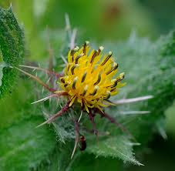
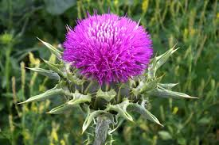
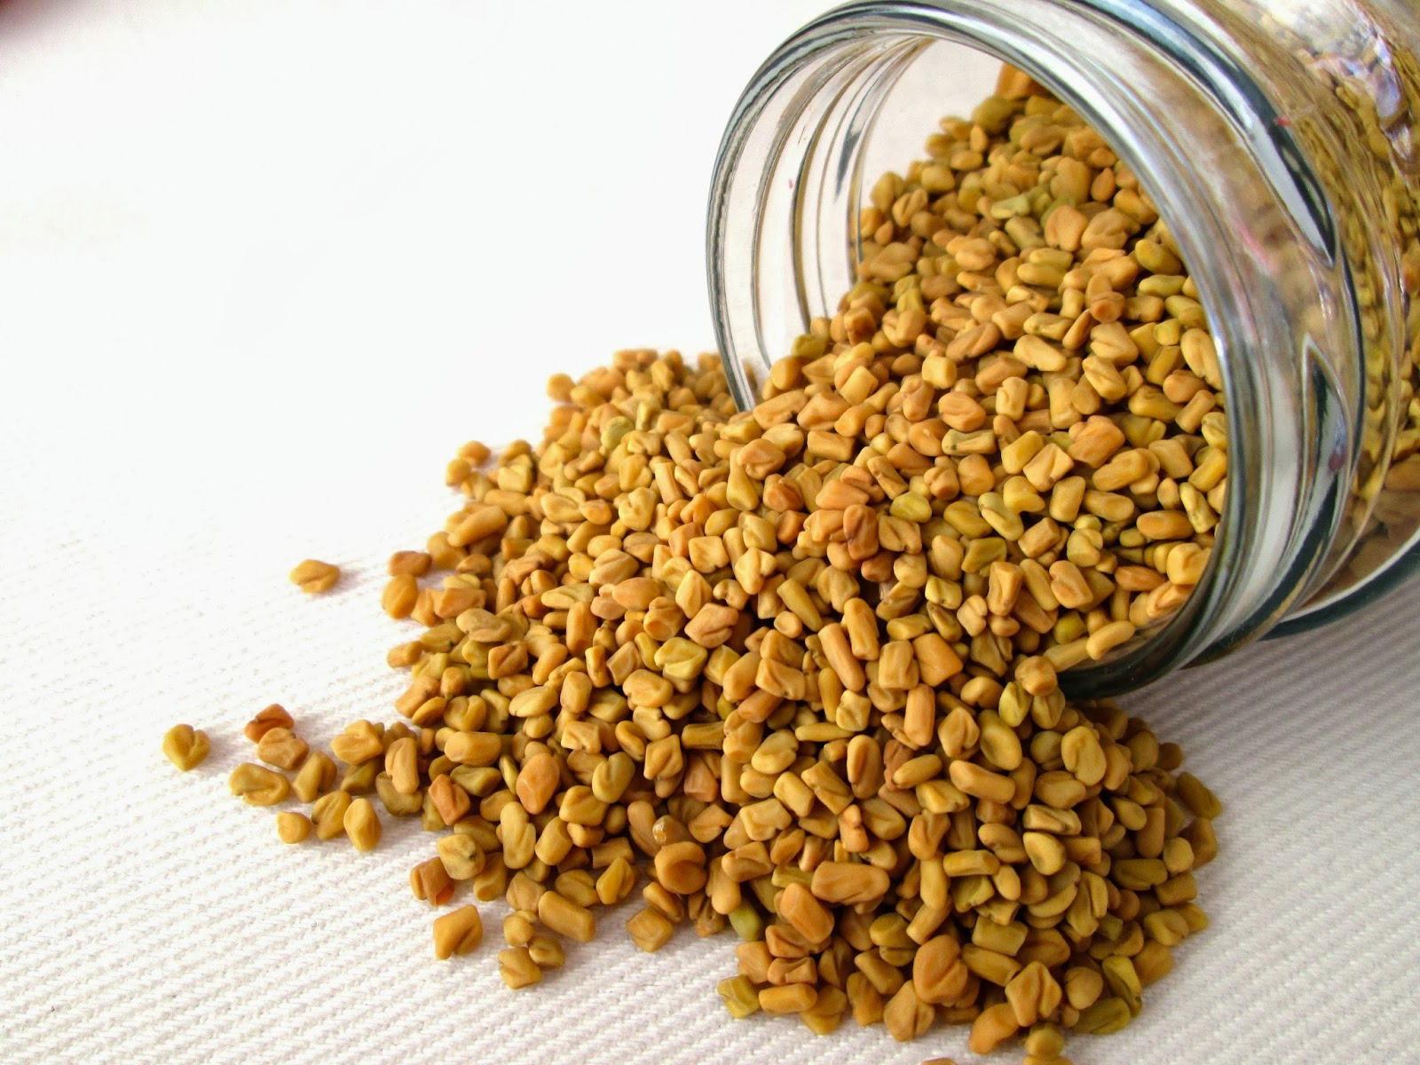

Slide 12
Hormone Balancers
Moringa – a food herb from India and Africa. It is used extensively in anti hunger campaigns. The shoots, leaves, and beans are used. Hormone modulator, very good at fixing nutrients, can have anti-fertility affects, the bark can cause uterine contractions. Reduces blood sugar levels.
Shatavari – a traditional Ayruvedic herb. A phyto-estrogen so contraindicated for women with estrogen sensitive issues. Reduces blood sugar.
Goats Rue – insulin sensitizing galactagogue. Very effective for some women. Can increase glandular tissue. Biggest use in animal husbandry to increase the milk supply of cows!
Alfalfa – estrogenic. May interfere with birth control. Highly nutritive herb as well a diuretic.

Slide 13
Red Raspberry Leaf
Phyto-estrogen. Nutritive herb. Uterine tonic. May help with let down. Very mild laxative. Anti nausea.

Slide 14
Nutritive and Trophorestorative Herbal Galactagogues.
Stinging Nettle: Part used: seeds and above ground plant. Nettle is a wonderful anti inflammatory. Excellent for allergies. Very nutritive plant.
Oat Straw: part used: milky seed, straw. Oat Straw is best extracted in cold water. Excellent source of minerals especially magnesium. Milk oat top tincture is made from the seed heads before they set. It is a mild sedative and restorative. There is nothing particular about oat’s chemistry that lets us know why this is. Really good for moms struggling with stress, letdown, and sleep issues.
Chickweed: part used: leaf and stem. Another good source of minerals. Definite galactagogue. Demulcent herb good for mucus membranes.
Marshmallow: Part used: leaf and root. Another one that benefits from a long infusion. Marshmallow is what the traditional treats are made from. It is a wonderful mucilage herb that has sympathetic effects on all mucus membranes. It also has astringent properties that tone mucosal tissue. It is an emollient that works well for clogged ducts, engorgement, and mastitis.

Slide 15
Soy Lecithin: granules, capsules, or liquid form. It is helps suspend fats and proteins in liquids. Used for clogged ducts and shy letdown.
Barley: barley water or tea is a wonderful nutritive galactagogue and demulcent similar to oat in its actions. Most grains are milk making foods. This has a traditional use in Chinese medicine
Hops: part used: flower. Bitter and pungent. Hypnotic, sedative, diuretic, anti-spasmodic and helpful for nervous restlessness. Important ingredient in beer!
Lemon Balm: part used: leaves and flowers. Anti viral specifically for herpes, anti spasmodic useful for asthma, soothing for stress and nervous hysteria. Good for when a mom is struggling with stress and nervousness.
Elder: part used: berry and flower. Antiviral, antispasmodic

Slide 16
Herbs to down regulate supply
In general the herbs that will down regulate supply are herbs that are very hot, astringent, and drying. The draw fluid and decrease in the same way that an antihistamine would. Used judiciously they can be allies when women are struggling with over supply or severe engorgement.
Sage
Parsley
Peppermint: especially the essential oil
Basil/Holy Basil
Potato
Cabbage

Slide 17
Marijuana
Marijuana is one of our most complex herbs. We are really only beginning to understand the constituents. THC the chemical that produces euphoric high is only a small part of the plant chemistry though certainly a potent one. It also contains phytocannabiniods, terpenoids, and flavonoids phytosterol components. Most of the properties of the known chemistry cover actions like: anti inflammatory, antioxidant, antidepressant, antibiotic, antifungal, antiemetic, sedative, stimulant, antiviral, analgesic, and of course the well known psychoactive.
Two main strains of marijuana – Indica and Sativa
Indica is a less psychoactive strain. It is indicated for deep muscle pain, spasms, sleep disorders, nausea, depression, increasing appetite. It is used when the primary goal is pain relief while still functioning.
Sativa is a very potent psychoactive strain of this plant. It is used to treat glaucoma, muscle tension, loss of appetite, and insomnia.

Slide 18
THC and many cannibids are soluble in fat. They are metabolized and stored in fat which is why there has been concern for breastfeeding infants since breast milk is high in fat. The thought is that baby will get a more concentrated dose through breast milk. ABM has now decided that the risk does not outweigh the benefits, and so while women are encouraged to quit smoking pot, the benefits to baby are still better then formula.
As an herbalist this is my experience. The use of pot seems to inhibit the letdown function. I think this is do to the sedative and antispasmodic properties of the plant. Mothers experience full breasts but just dribble milk. This may not be a problem for women with over supply or over active letdown but can be a problem for a mom with low supply or with a baby that has suck issues. My theory is that it interferes with the oxytocin uptake or trigger in letdown since it relaxes muscle fibers. I think that long term use may be problematic for supply.

Slide 19
Resources
The Nursing Mothers Herbal: Sheila Humphrey
Mother Food: Hilary Jacobson
The Practice of Traditional Western Herbalism: Matthew Wood
Natural Health After Baby: Aviva Romm
Botanical Medicine for Women’s Health: Aviva Romm
Aromatherapy and Herbal Remedies for Pregnancy, Birth, and Breastfeeding: Demetria Clark
Herb, Nutrient, and Drug Interactions: Clinical Implications and Therapeutic Strategies: Stargrove, Treasure, and McKee

Slide 20
Herbal Resources
Mountain Rose Herbs – Bulk Herbs and supplies
Wish Garden Herbs: breastfeeding and pregnancy safe herbal remedies
MotherLove: tinctures, capsules, and teas
Herb Farm: Tinctures and bulk herbs
Nutritional Medicinals: teas – the ever popular Mothers Milk Tea!

