Slide 1
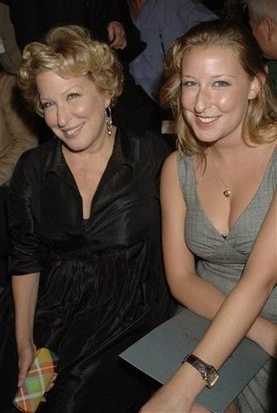
There is more of your mother in you than you thought!
Ameae M. Walker
Professor of Biomedical Sciences
School of Medicine
University of California, Riverside
UCR Vice Provost for Academic Personnel

Slide 2
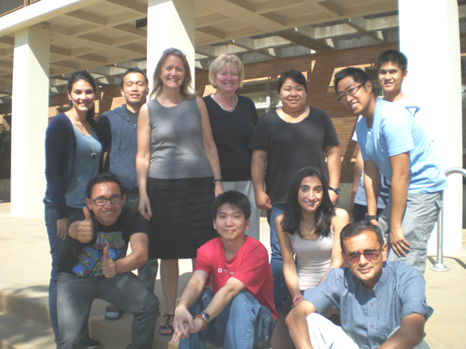
The Walker Lab group
Lisa Ma
Riva Dill
Mrinal Ghosh
This work funded by NIH Institute for Child Health and Human Development grant # R01HD065099
We declare no conflicts of interest

Slide 3
Learning objectives
Review
Review basics of cell-mediated immunity
Learn about
Learn about the transfer of immune cells via breastfeeding and their lifelong effect on offspring cell-mediated immunity
Discuss
Discuss how to apply this new knowledge to real world improvement of immunity

Slide 4
What cells are important to T cell-mediated immunity?
These T cells help other immune cells. Exactly which and how depends on local circumstances
CD4+ T cells
Helper cells (CD4 more!)
CD8+ T cells
Cytotoxic cells
(CD8 hate!)
These T cells recognize other cells that are cancerous or are infected, and kill them

Slide 5
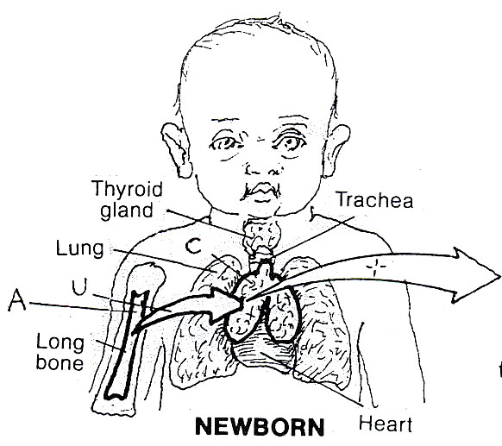
Why are they called T cells?
T cells out to the rest of the body
Precursor cells enter the thymus from the bone marrow and once in the thymus produce the different T cell types

Slide 6

T cells have T-cell receptors, which through a random recombination process can bind to small portions of all normal and many abnormal proteins
T cell receptor

Slide 7
This T cell receptor is placed on the surface of a T cell.
T cell receptor

Slide 8
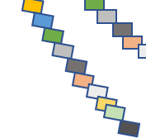
At the same time, it is the job of every cell of the body to digest each of its own proteins to display little pieces of them on the cell surface attached to MHC I molecules
MHC = Major Histocompatibility complex, also called HLA in humans
MHC I
Any cell of the body

Slide 9
If the T cell receptor can bind to what is displayed on the MHC I molecule, then T cell killing is initiated
Cytotoxic T Cell
T cell receptor
MHC I
So, just knowing this much, what is the potential problem?
Any cell of the body

Slide 10
In the thymus, the Cytotoxic T cells that interact with parts of normal proteins are killed off
Yet to be released Cytotoxic T Cell
T cell receptor
MHC I
Thymic epithelial and other cells

Slide 11
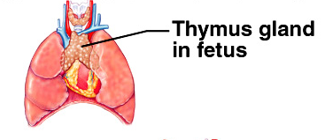
Cells that leave the thymus theoretically should not kill normal cells
So, what are they for?

Slide 12
For example
If a cell is infected with Mycobacterium tuberculosis , then proteins from the bacterium are displayed using the same process
If a protein becomes mutated in cancer , then the abnormal part of the protein will be displayed
Similarly, if a cell is infected with a virus , then parts of viral proteins are displayed

Slide 13
The cytotoxic T cells that left the thymus then may recognize these abnormal (non-self) parts of proteins and initiate killing of infected or mutated cells
Cytotoxic T Cell

Slide 14
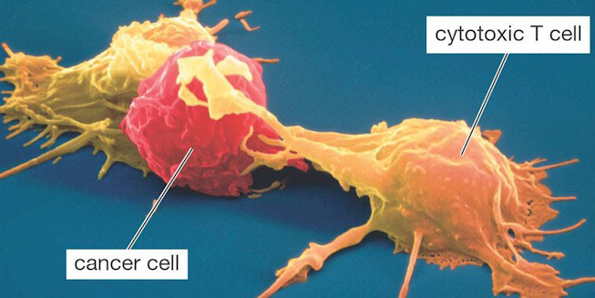

Slide 15


Slide 16
Learning objectives
Review
Review basics of cell-mediated immunity
Learn about
Learn about the transfer of immune cells via breastfeeding and their lifelong effect on offspring cell-mediated immunity
Discuss
Discuss how to apply this new knowledge to real world improvement of immunity

Slide 17
Why did we focus our attention on the thymus when considering the effects of breastfeeding?

Slide 18
Effects of breast feeding on thymus size in infants at 4 months of age
Feeding | Mean Relative Volume Estimate from Ultrasonography
Exclusively breast fed, n=21 | 38.3
Partially breast fed, n=13 | 27.3
Exclusively formula fed, n=13 | 18.3
Hasselbalch et al., Acta Pediatr 85: 1029 (1996)
The thymus is twice the size in exclusively breast fed versus bottle fed infants at 4 months of age!

Slide 19
Breast Milk contains
Basic nutrients : Fat, Carbohydrate and protein and some of these (e.g. fatty acids and casein peptides) have been reported to influence immunity in the offspring (Laitinen at al., Pediatr Res 59:723,2006; Jorgenson et al., J Peptide Sci 16:21,2010)
Antibodies (IgA, IgM, and IgG) that enter the baby’s blood stream. This is called passive transfer of immunity (Van de Perre, Vaccine 21:3374-3376, 2003 )
Cytokines and chemokines are small peptide hormones that could affect development of the infant’s immune system
Immune cells ~10⁸-10⁹/L in human milk
BUT The immunomodulatory effects of breast milk in offspring continue after the termination of breast feeding and beyond the life span of antibodies, cytokines, and nutrients -- into adulthood

Slide 20
Mouse as an experimental model
Placental structure varies among mammals. Immune cells can transfer via the placenta in some mammals – e.g. mice and humans (hemochorial), but not cows (epitheliochorial)
Mice and humans both transfer immune cells via placenta, and their milk contains immune cells
Human stomach does not gain acidity of adult until 3 months of age
Infants and mouse pups have poor cell-mediated immunity, which would allow at least temporary survival of transferred cells. This means that mother’s cells would be poorly recognized as foreign and therefore would not be killed.

Slide 21


Mouse mommies nurse for 21 days and then the pups are weaned.
We have used foster-nursing protocols and looked at cells in the milk on days 3, 7, 14 and 21

Slide 22
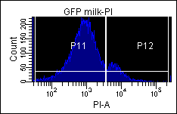
Greater than 80% of cells in the milk clot in the pup stomach are alive at two weeks of lactation
A
Propidium Iodide staining and analysis by flow cytometry of cells isolated from the whey clot from the stomach of a pup at 2 weeks of lactation
Live cells have been reported in the stools of infants at 2 months of age

Slide 23
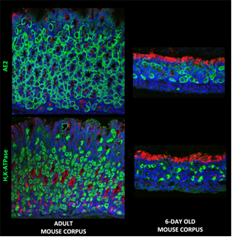
Development of stomach parietal cells-the cells that make acid
Both H,K-ATPase and the anion exchanger-2 (AE-2) are critical for making acid. Both are present at 6 days, but limited in number. pH measurement of stomach contents showed limited acidity. Work conducted with Chris Lytle. As mentioned earlier, stomach acid not normal until 3 months in infants

Slide 24
Types of immune cells present in milk clot at week 2
NB. Mice not in a sterile environment
B cells
T cells
Macrophages
percentage of milk CD4+, CD8+, γδ TCR+ (GD), Foxp3+, B220+, CD3+, and F4/80+ cells found within the clot, as determined by flow cytometric analysis.

Slide 25
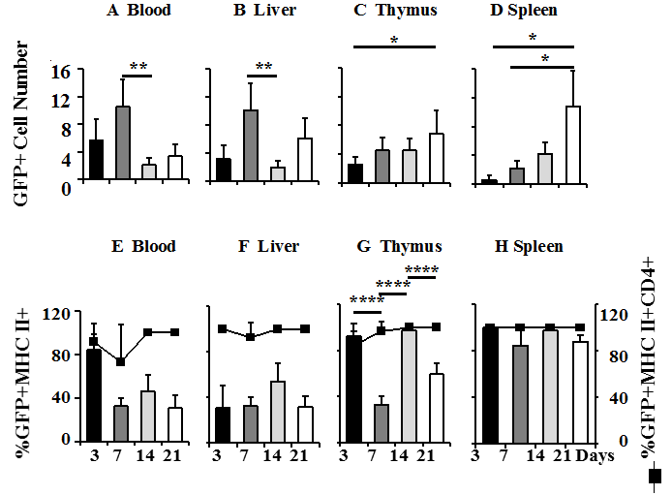
3 7 14 21 3 7 14 21 3 7 14 21 3 7 14 21 days
Maternal cells (identified in 4 different mother-pup foster pairings pass into the blood and accumulate over the lactation period in thymus and spleen

Slide 26
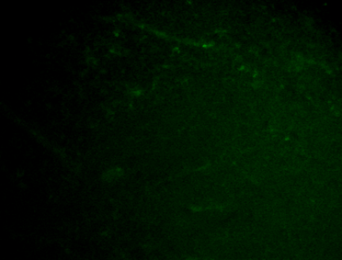
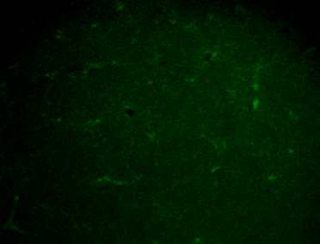
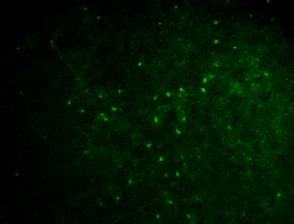
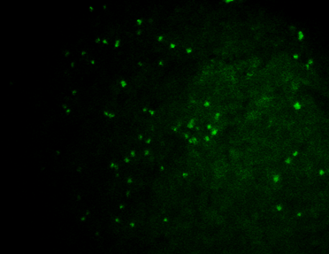
Where do they go? Spleen and Thymus. This is thymus
1 week
1 week
2 weeks
2 weeks
3 weeks
3 weeks
4 weeks
4 weeks

Slide 27
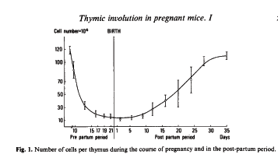
Because the thymus involutes during pregnancy in mice and women
T cells placed in milk come from the periphery and so many are “experienced”.
They are stimulated to travel into the milk by prolactin
Dill R, Walker AM. J Mammary Gland Biol Neoplasia. 2017, 22:13-26
Phuc et al. Clin Exp Immunol 44:247 (1981)

Slide 28








If we immunize mom with BCG (bovine tuberculosis) does this transfer to baby?
PPD
BCG
9 W
3 W
Weeks
Splenocytes

Slide 29
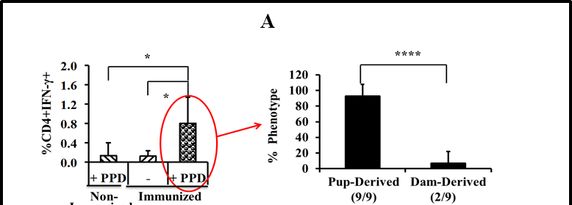
Pups at 5 weeks
Immunized

Slide 30
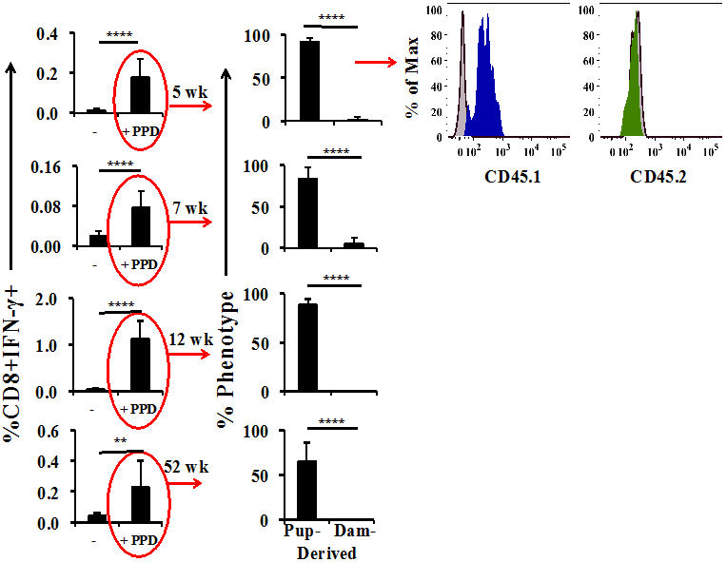
At early time points, some of the cytotoxic cells responding to parts of the tubercle bacillus came from mom. This is passive cellular immunity, much like passive receipt of antibodies from mom via the milk.
All of mom’s cells are gone by 12 weeks, but there is still immunity at 52 weeks.
Ghosh MK, Nguyen V, Muller HK, Walker AM.
J Immunol. 2016; 197:2290-6
How did this happen?

Slide 31
While Mom’s cytotoxic T cells were initially working to help protect the pup, BCG-experienced helper memory cells (CD4+) were travelling to the thymus
In the thymus, these cells promoted the production of pup cytotoxic T cells that specifically respond to parts of the tubercle bacillus.
CD8
CD8
CD4+
CD8
Mom cell
CD8
Pup cells

Slide 32
Comparing resultant immunity between those directly immunized and those immunized via the milk, there is increased efficiency for BCG and this occurs between moms and pups from very different strains
*
**
B
******
****
%CD8+ also IFN-γ+
- PPD + PPD + PPD + PPD
Control
Pup directly
immunized
Non-immunized
Pup fostered by Immuniz-ed dam
Non-immunized
Pup fostered by
immunized
dam with
Dam cells
removed

Slide 33
Summary
During breastfeeding, mom’s cells can directly be responsible for important cell mediated immunity. This is passive cellular immunity
Others of mom’s cells go to the pup thymus, where their presence dictates the production of cytotoxic T cells that are the same as mom’s cytotoxic T cells, capable of attacking cells infected with tubercle bacilli. This is what we have called maternal educational immunity.
Because the thymus has now produced responding pup cells, mom’s cells can die and the pup cells allow for lifelong immunity against TB
Maternal educational immunity is more efficient than direct immunization in young animals.

Slide 34
There is more of your mother in you than you thought!
Not only do you have her genes, but she
Protected you with her own cells initially
arranged for your thymus to produce cells modelled on her own immunological experience

Slide 35
Learning objectives
Review
Review basics of cell-mediated immunity
Learn about
Learn about the transfer of immune cells via breastfeeding and their lifelong effect on offspring cell-mediated immunity
Discuss
Discuss how to apply this new knowledge to real world improvement of immunity

Slide 36
What might this mean for clinical practice?
One more reason to breast feed
One more reason not to pasteurize breast milk
One more reason to support group breastfeeding – immune backgrounds of mothers are different and so this gives better coverage
Critical period is before acidity of stomach develops ~ 3 months
For BCG specifically (which is not that effective in the newborn and yet >4000 people a day die of the disease worldwide), pre-pregnancy immunization/boosters may improve protection

