Slide 1
Engaging Men and Dads at WIC: A Toolkit

Slide 2
Who we mean when we say ‘Dad’?
This toolkit can apply to any significant male figure in a child’s life:
Biological or adoptive father
Grandfather, uncle, older brother
Mother’s partner
Family friend
This important male figure may be:
A single parent
Living with the child
Living separately

Slide 3
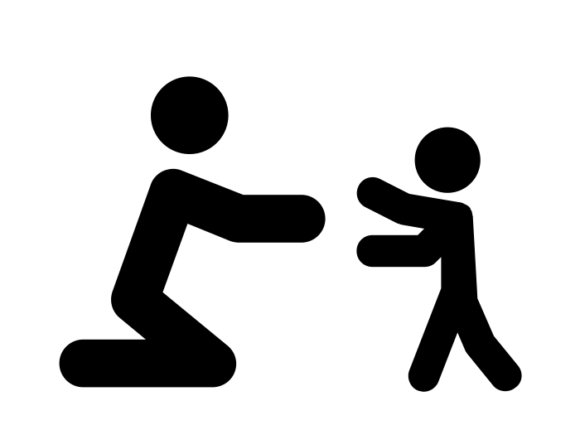
Benefits of Dad Involvement
When Dads are involved, children gain many benefits:
Better school performance and more likely to graduate high school
Increased self-esteem
Improved relationships with peers
Reduced frequency of behavioral and psychological problems
The family benefits as well!
Decreased stress related to parenting
Dads gain self-confidence

Slide 4
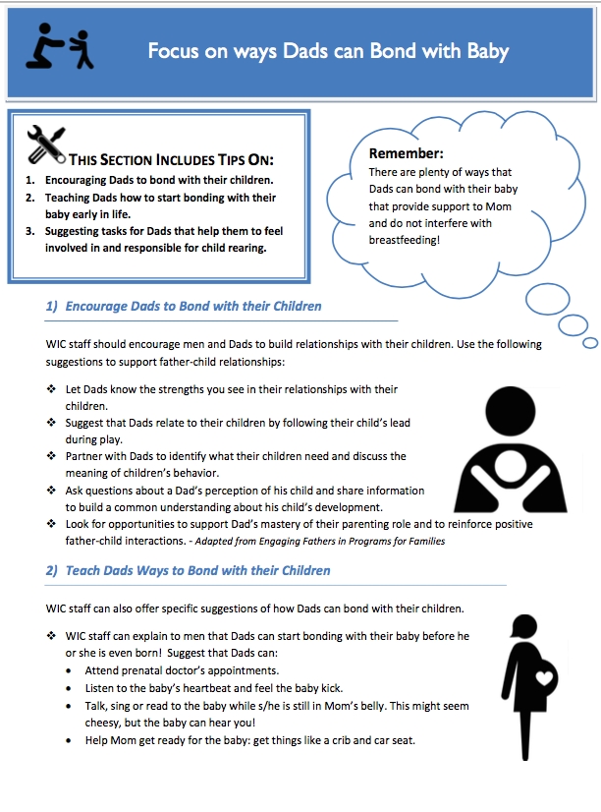
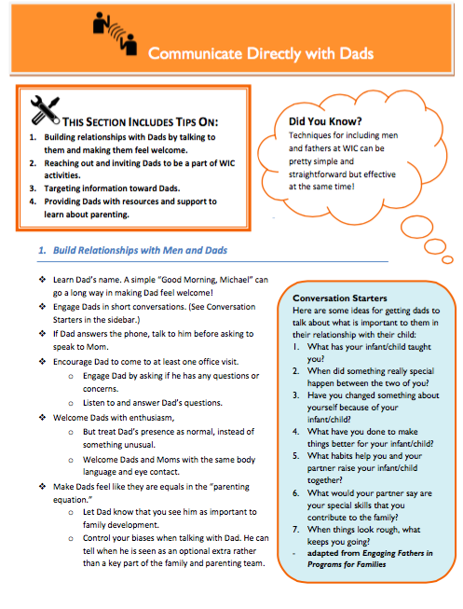
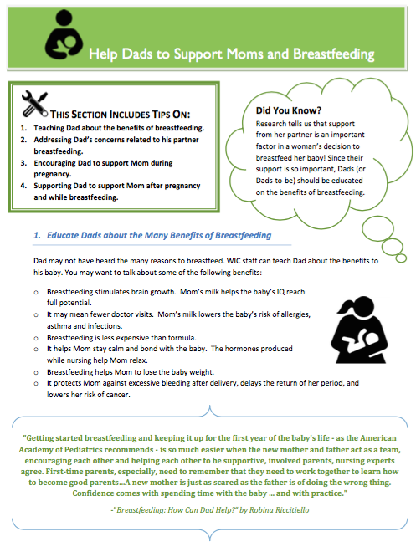
The Toolkit
A collection of best practices and suggested ways to enact those practices
Suggestions come from a variety of early childhood focused programs and organizations including:
WIC
Head Start and Early Head Start
Pre-school Learning Alliance (U.K.)
Best Start Resource Centre (Canada)
9 modules and links to resources in each
Possible to implement ideas from just one module or several!

Slide 5
Highlights from the Toolkit
Organizations agree that getting staff engaged with including Dads is critical.
Staff may be unaware of their interactions with Dads or feel resistant to including them.
It is important to be sensitive to staff members’ feelings and to have trainings and dialogue
Small changes to the physical environment can make a big difference!
E.g., including an additional chair in the counseling room or providing Dad friendly reading material in waiting areas
It is important to think about framing and to present outreach efforts in language that is appealing to Dads
E.g., talk about finding solutions and building skills rather than support and sharing

Slide 6
Reaching out & Including Dads at WIC
Some ideas from the toolkit to try:
Build relationships with Dads by talking to them and making them feel welcome
Reach out to individual Dads and invite them to be a part of WIC activities
Provide Dads with resources and support to learn about parenting
Have men present at the office as employees, volunteers, peer group leaders, etc.
Keep in mind Dad’s time and work conflicts and consider offering evening hours

Slide 7
Focus on Breastfeeding & Bonding
The toolkit explores ways that WIC staff can help Dads to support Moms during breastfeeding. For example, staff can:
Answer Dad’s questions about breastfeeding and respond to any concerns
Suggest ways that Dads can provide support and help out his partner
Another module focuses on ways that Dad can be involved with the baby/child that do not interfere with breastfeeding. Dad’s may be especially good at:
Interpreting baby behavior
Focusing on developing their child’s brain
Active play

Slide 8
Going Even Further to Include Men and Dads
When a father involvement project gets further underway, the toolkit has additional ideas to explore such as:
Peer groups for men and Dads
Building community partnerships
Increasing referrals for Dads
Evaluating your efforts to see what works

Slide 9
References
http://www.ncbi.nlm.nih.gov/pubmed/18052995
http://greatergood.berkeley.edu/article/item/six_obstacles_to_father_involvementand_how_to_overcome_them
http://www.calwic.org/component/content/article/10-engaging-wic-families/318-engaging-men-a-dads-at-wic
Image credits:
Hug by Yu luck
First Steps by Jessica Lock
Breastfeeding Symbol by V. Kuroji Patrick
Parenthood by Juan Pablo Bravo
This work is supported by a generous grant from The David and Lucile Packard Foundation.

Slide 10
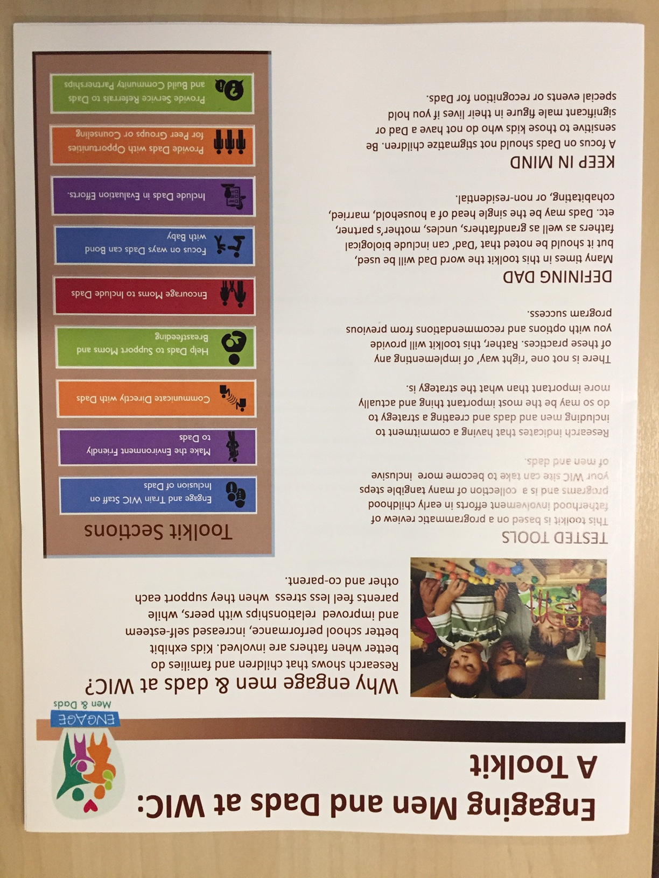
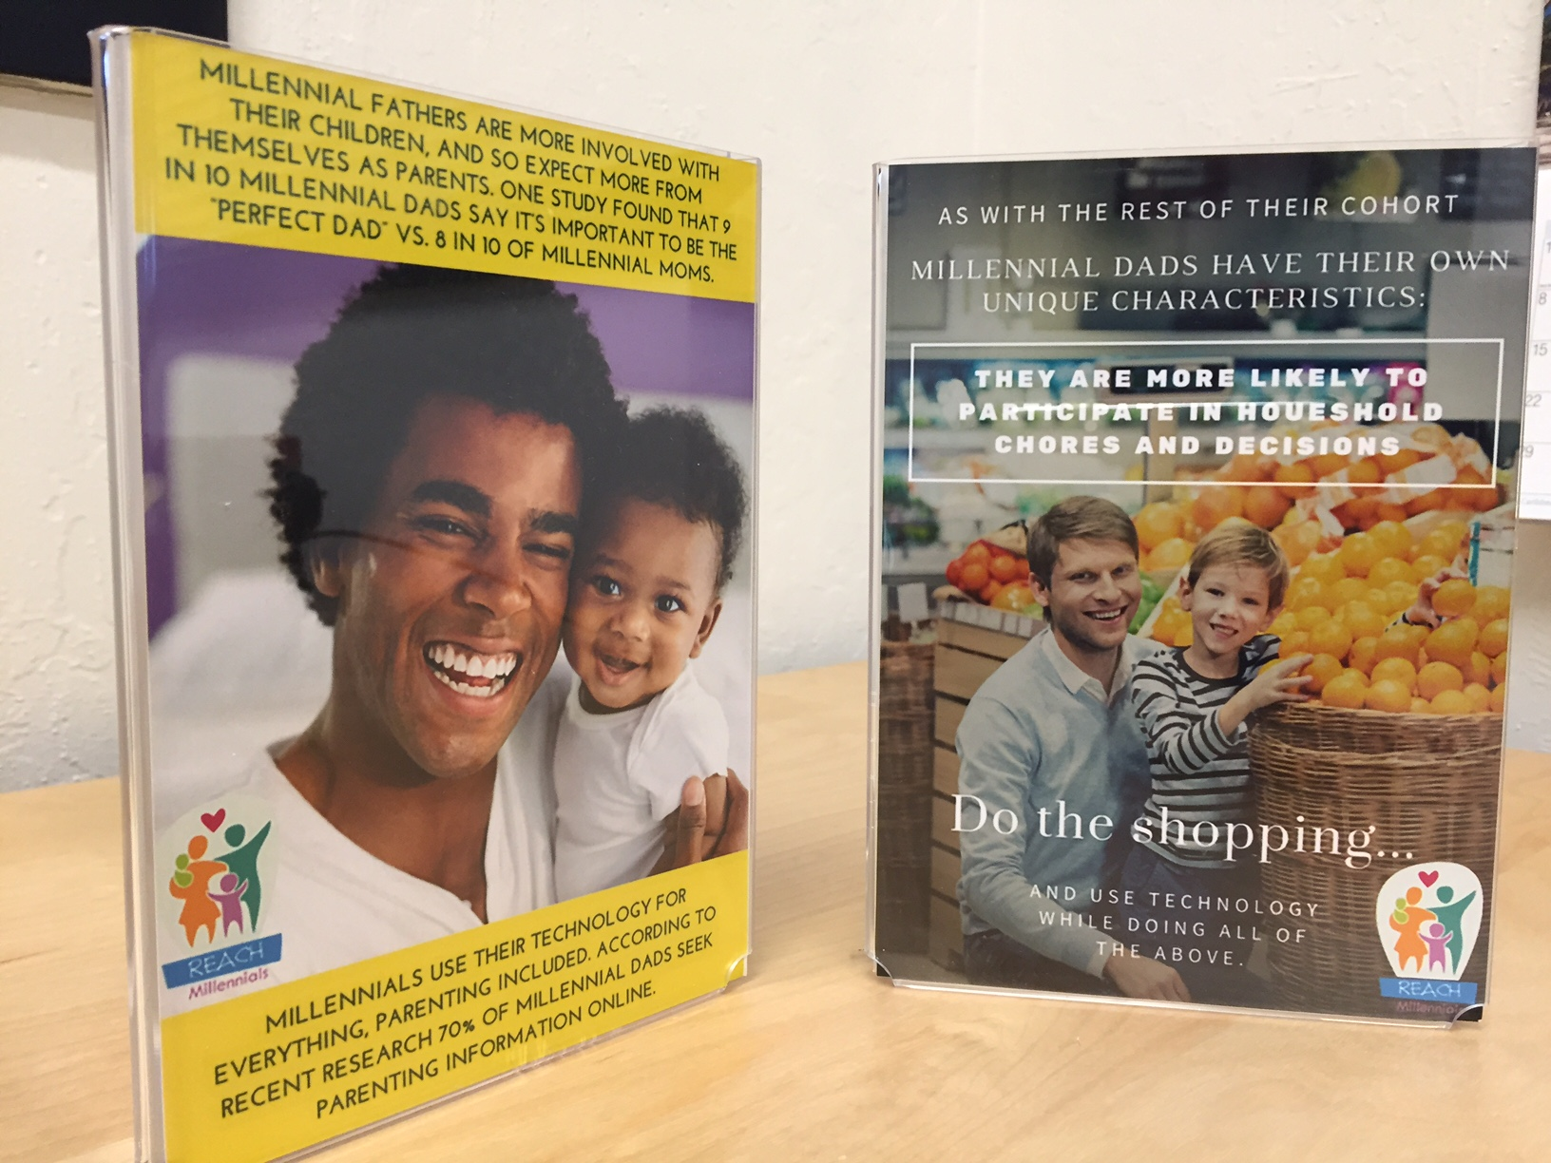
Get the toolkit and resources!
http://calwic.org/storage/documents/MenDadsToolkit/Men_and_dads_combined_file.pdf
Download photos tools for your clinic or office!
http://calwic.org/storage/documents/MenDadsToolkit/Men_and_dads_combined_file.pdf

