Slide 1
Lactation Accommodations and Family/Medical Leave: A Legal Landscape
Ruth Dawson, Staff Attorney | Monica Ramsy, Legal Intern
ACLU of Southern California

Slide 2
Lactation Accommodations

Slide 3
Federal Laws Protecting Breastfeeding Employees
Title VII
Title IX
Affordable Care Act (ACA)

Slide 4
Title VII of the Civil Rights Act of 1964
The Pregnancy Discrimination Act of 1978 amended Title VII to include pregnancy, childbirth and related conditions
States that “women affected by pregnancy, childbirth, or related medical conditions shall be treated the same for all employment related purposes”
Covers employers with 15 or more employees
Applies to private companies, employment agencies, labor organizations and government employees
Source: 42 U.S.C. § 2000e

Slide 5
Title IX of the Education Amendments of 1972
No federally funded educational program or activity can discriminate against a person based on their sex
Applies to employees at colleges, universities, elementary and secondary schools, as well as any other educational institution that receives federal funding
Guidance issued by OCR confirms that Title IX applies to pregnancy, childbirth and related conditions (such as breastfeeding) because they are related to a person’s sex
Sources: 20 U.S.C. §1681; U.S. Department of Education Office of Civil Rights, Supporting the Academic Success of Pregnant and Parenting Students Under Title IX of the Education Amendments of 1972 (2013).
Notes:
Source

Slide 6
The Affordable Care Act (ACA)
Requires employers to provide reasonable break time for nursing mothers for up to one year after the child’s birth
Break time is unpaid unless the employee uses a break that is normally a paid break to express milk -- if so, must be paid
A private space shielded from coworkers and the public that is not a bathroom
Some circumstances where an employer can refuse to accommodate an employee
No retaliation
Source: 29 U.S.C. 207(r)

Slide 7
State Laws Protecting Breastfeeding Employees
Public Breastfeeding Laws
Fair Employment and Housing Act (FEHA)
Unruh Civil Rights Act
California Ed. Code (lactation accommodation in schools)

Slide 8
Public Breastfeeding (CA State Law)
People have a right to breastfeed in public and in government buildings.
We and other advocacy groups have received many complaints from parents told they cannot breastfeed on school grounds during school events and teacher conferences.
Source: Cal. Civil Code § 43.3.
  This isn’t true!

Slide 9
California Fair Employment and Housing Act (FEHA)
Discrimination because of breastfeeding or lactation is a form of sex-based discrimination and is prohibited. It is illegal for an employer to discriminate on the basis of lactation with respect to hiring, firing, training, compensation, or virtually any other aspect of employment.
  Applies to workplaces with 5 or more employees as well as all employment agencies, labor organizations, state licensing boards, and state and local governments.
FEHA was amended in 2012 to clarify that “sex” includes breastfeeding or medical conditions related to breastfeeding.
Discrimination includes: failure to reasonably accommodate pregnancy or lactation; harassment based on pregnancy or lactation
  Source: Cal. Gov’t Code § 12925 et seq. For more information, go to: https://legalaidatwork.org/factsheet/rights-for-breastfeeding-mothers-lactation-accommodation-and-discrimination/

Slide 10
Unruh Civil Rights Act
Prohibits sex discrimination in public accommodations (including schools)
Defines sex to include pregnancy, childbirth, or medical conditions related to pregnancy or childbirth.
Source: Cal. Civil Code § § 51(b), (e)(5)

Slide 11
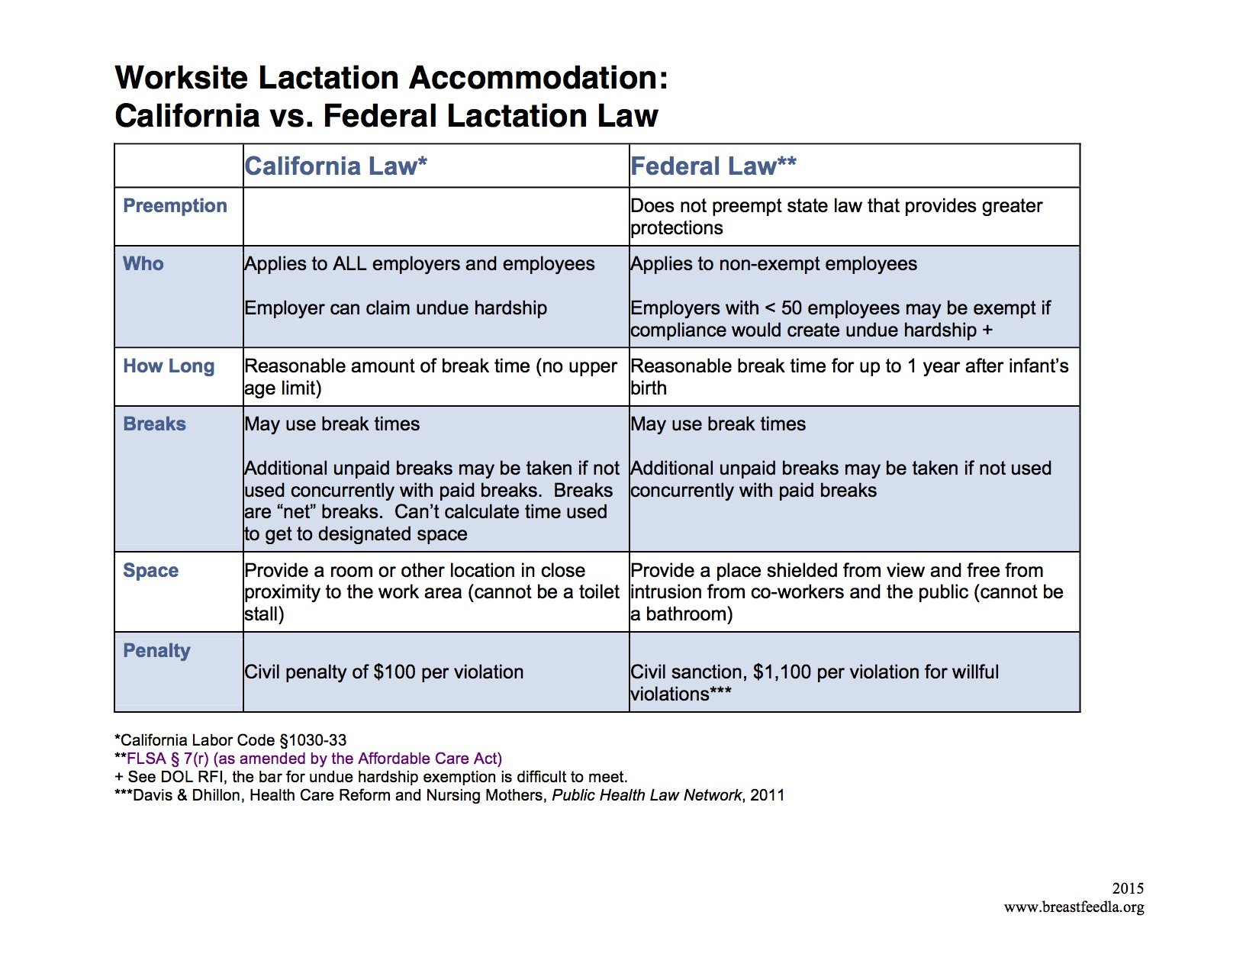
Worksite Lactation Accommodation Law: An Overview

Slide 12
Lactation Accommodation in Schools
CA state law (corresponds with Title IX):
  If a school provides reasonable accommodations to students with temporary medical conditions, must do the same for breastfeeding students.
  Accommodations must be made for breastfeeding employees
    Employees are also protected from any retaliation for taking breaks to breastfeed and pump.
  Treating lactating student, employee, or parent/guardian differently or denying reasonable accommodations is sex discrimination.
Sources: Cal. Ed. Code §§ 201, 220, 222
For more information about discrimination and accommodations laws for pregnant students and employees in schools, see: http://breastfeedla.org/wp-content/uploads/2015/10/BFLA-School-District-Laws-1.pdf.

Slide 13
Lactation Accommodation in Schools
TITLE IX Coordinator
Schools must also:
Designate at least one person to be their Title IX Coordinator
Notify students how to contact their Title IX Coordinator
Adopt and publish grievance procedures to be followed if a Title IX issue arises.
Sources: 14 CFR 1253.135(a); California Department of Education, "Gender Equity and Discrimination Laws in California Public Schools", http://www.cde.ca.gov/re/di/eo/genequitytitleix.asp.

Slide 14
Lactation Accommodation in Schools
All public or charter schools with at least one student who is lactating must:
  Provide a private, secure room—other than a restroom—to deal with any needs associated with breastfeeding or expressing milk
  Allow lactating students to bring any equipment used to express breast milk to school, including a breast pump
  Provide access to a power source for that equipment
  Provide a place to safely store expressed milk
Sources: 29 U.S.C. § 207(r); Cal. Educ. Code § 222; Cal. Labor Code §§ 1030-31; ACLU of Cal., BreastfeedLA & Cal. Women’s Law Center, ABC’s of Breastfeeding in Los Angeles County School Districts (2015)

Slide 15
Lactation Accommodation in Schools
✓Provide students with reasonable time or time away from the classroom to accommodate their lactation schedule
✓Ensure students do not incur an academic penalty for any such breaks they may require
✓Ensure students have the ability to make up any work missed during these breaks
Sources: 29 U.S.C. § 207(r); Cal. Educ. Code § 222; Cal. Labor Code §§ 1030-31; ACLU of Cal., BreastfeedLA & Cal. Women’s Law Center, ABC’s of Breastfeeding in Los Angeles County School Districts (2015)

Slide 16
Lactation Accommodation in Schools – Complaint Filing Process
Title IX and CA Uniform Complaint Procedures are available
Accept and investigate complaints of noncompliance under the Uniform Complaint Procedure, which requires schools to investigate complaints and issue a decision within 60 school days
Decisions may be appealed to CDE, which must issue a final, written decision within 60 days of filing
Sources: Cal. Educ. Code § 222; BreastfeedLA & Cal. Women’s Law Center, ABC’s of Breastfeeding in Los Angeles County School Districts (2015)

Slide 17
State Law Penalties for Violations
Labor Code § 1033
  Failing to provide a lactation break
    Each violation has a penalty of $100
Discrimination
  Compensatory damages, money for lost wages, unpaid wages, medical costs
  Punitive damages
  Legal expenses

Slide 18
Asking for Accommodations
Talk to supervisor about your intention to pump breast milk while at work before going on leave.
  This timeline provides your supervisor with time to identify an appropriate location to pump and to think with you about how to best incorporate time for pumping into your work day.
Provide this sample “Doctor Support for Lactation Accommodation” letter to your healthcare provider to supplement your lactation accommodation request
  https://legalaidatwork.org/wp-content/uploads/2017/02/Doctor-Letter-Supporting-Lactation-Accomodation-00438437-3.doc
Sources:
  University of Minnesota Lactation Advocacy Committee, “Talking to Your Supervisor about Lactation Needs”, http://humanresources.umn.edu/sites/humanresources.umn.edu/files/wau030-04_talking_to_your_supervisor_about_lactation_needs.pdf;
  Legal Aid at Work, DO-IT-YOURSELF: SAMPLE LETTERS, TOOLKITS, AND GUIDES, https://legalaidatwork.org/do-it-yourself-sample-letters-toolkits-and-guides/

Slide 19
Asking for Accommodations: Anticipating Frequently Asked Questions
Questions | Answers
Why is it so important that you breastfeed? | By breastfeeding my baby, I am doing the best for my baby, myself and my employer. Mothers of breastfed babies often miss work less because their babies are sick less. When employees and their families are healthy, their employers have lower medical costs. And now, workplace support for nursing mothers is required by federal law.
How much time off do you need to pump? | The same amount of time every employee takes for breaks, about twenty minutes every three hours. Federal law requires employers to let nonexempt nursing mothers take the breaks they need to pump milk for a year after their babies are born.
Why can’t you use the women’s restroom to pump? | Because I am preparing food for my baby, and require a sanitary place in which to do so. Federal law also requires employers to provide a place for nursing mothers to pump that is not a bathroom.
Source: Families at Work Institute, “Talking about Breastfeeding”, http://familiesandwork.org/employer_lactation_toolkit_downloads/010214_TalkingAboutBreastfeeding.pdf.

Slide 20
How to Handle Violations
Resolve the dispute with your employer
File a complaint with an administrative agency
File a civil lawsuit

Slide 21
Filing a Complaint with an Administrative Agency
Options for filing a complaint:
The California Division of Labor Standards Enforcement (DLSE)
Department of Labor (if employees are covered by section 7 of the Fair Labor Standards Act)
Department of Fair Employment and Housing (DFEH)
  Failure to provide lactation accommodations is unlawful under FEHA
Complaints must be made within one year. If employees have questions about lactation accommodations at work, they can contact Legal Aid at Work through:
  Work & Family Program
  (800) 880-8047 helpline
Source: Legal Aid at Work, “Rights for Breastfeeding Mothers: Lactation Accommodation and Discrimination”, https://legalaidatwork.org/factsheet/rights-for-breastfeeding-mothers-lactation-accommodation-and-discrimination/.

Slide 22
Filing Lactation-Based Discrimination Claims
Maintain a detailed record of all acts of discrimination with the names of all witnesses.
File a complaint with the Department of Fair Employment and Housing (no later than one year after the earliest discriminatory act).
Be sure to name as defendants all responsible parties.
  For example: the company, the harassing parties, your supervisor(s), etc.
Contact an attorney or Legal Aid at Work’s “Work and Family Helpline” (415.593.0033)
  Source: Legal Aid at Work, “Rights for Breastfeeding Mothers: Lactation Accommodation and Discrimination”, https://legalaidatwork.org/factsheet/rights-for-breastfeeding-mothers-lactation-accommodation-and-discrimination/.

Slide 23
Other situations where lactation accommodation issues may arise…
Incarcerated individuals
Individuals participating in court-mandated community service

Slide 24
Family/Medical Leave

Slide 25
Leave & Breastfeeding – CA State Law
Cal. Gov’t Code § 12945:
  Employers cannot prevent employees disabled by pregnancy, childbirth, or a related medical condition from taking leaves of a "reasonable period of time" (up to 4 months)
    Regardless of whether breastfeeding or not
Lactation is not a disabling condition

Slide 26
Two Major Types of Leave
Job Protection Leave
FMLA/PDL
CFRA
Wage Replacement Leave
PFL
SDI

Slide 27
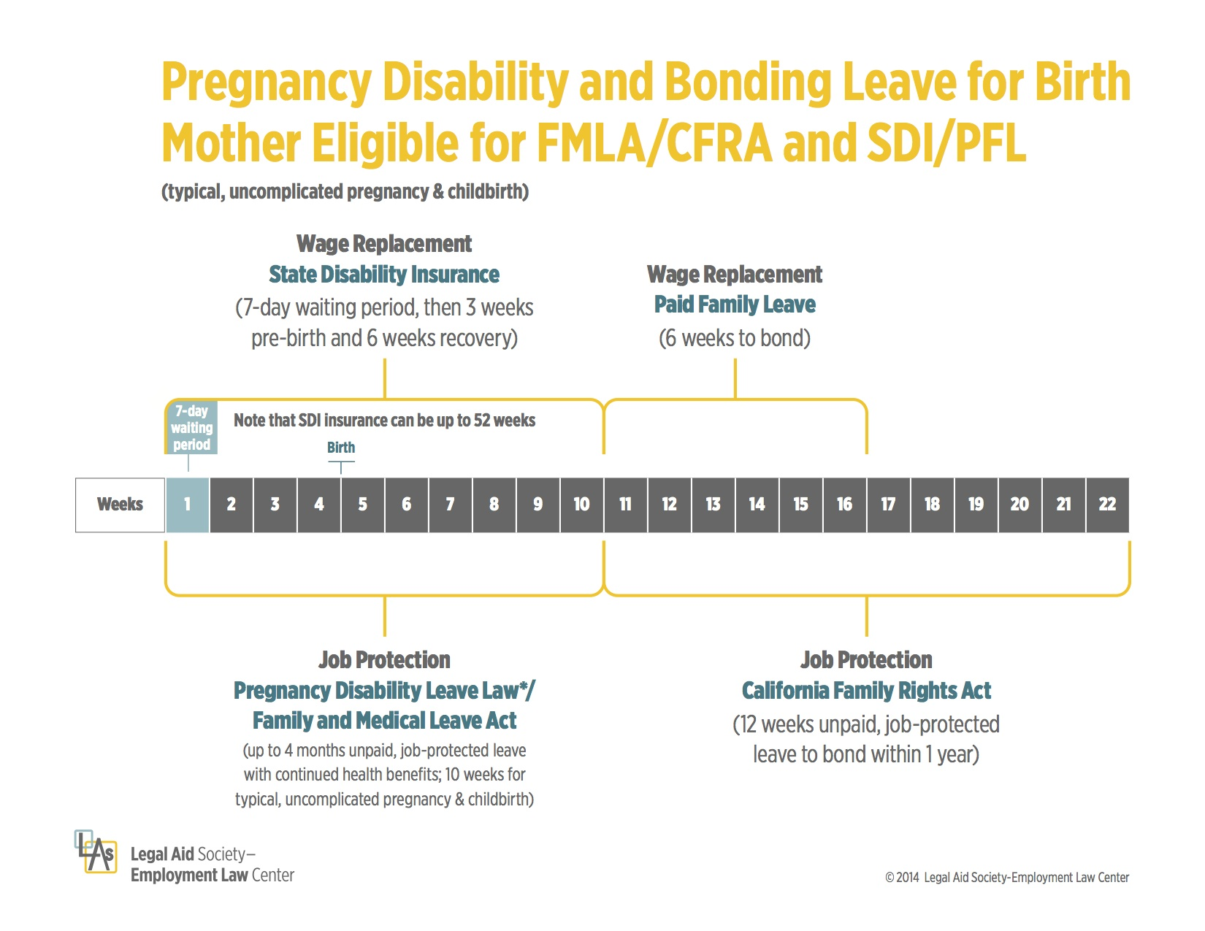
Paid leave and job-protected leave do not necessarily overlap!

Slide 28
Job Protection (Federal Law):
Family Medical Leave Act (FMLA) of 1993
Federal law that gives employees the ability to take time off from work to care for a family member with job protection
  Employees are entitled to up to 12 unpaid work weeks in a 12 month period
  Can take FMLA all at once or intermittently
Unpaid
Will run concurrently with PDL if an employee is PDL-eligible
Source: 29 U.S.C. § 2601
Notes:
Source?

Slide 29
Job Protection (State Law):
Pregnancy Disability Leave (PDL)
An employee is entitled to take unpaid PDL so long as:
  They are disabled due to pregnancy, childbirth or related medical conditions; and
  Their employer employs at least 5 employees.
Typical duration (10-12 weeks): 4 weeks before childbirth + either 6 weeks after a vaginal delivery or 8 weeks after a C-section delivery
  Employees can receive a maximum of 4 months of PDL for serious pregnancy-related conditions
If an individual is eligible for time off under FMLA, PDL leave will run at the same time as FMLA leave
Source: Cal. Code Regs. tit. 2, §§ 11035, 11037, 11042
For more information: https://www.dfeh.ca.gov/resources/frequently-asked-questions/employment-faqs/pregnancy-disability-leave-faqs/.

Slide 30
Job Protection (State Law):
California Family Rights Act (CFRA)
State law that provides job-protected bonding leave for up to 12 weeks after disability leave has ended.
Pregnant employees may take PDL for the time they are disabled and then CFRA leave for bonding with their child.
  Employees are also eligible for bonding leave under FMLA, but if a CA employee takes PDL, FMLA will not provide any additional bonding leave (the only available bonding leave would then be through CFRA)
There are many details involved in accessing bonding leave (see sources below!)
Sources: Legal Aid at Work, Taking Leave From Work: Pregnancy / Prenatal Care / Bonding with a New Child, https://legalaidatwork.org/factsheet/taking-leave-from-work-pregnancy-prenatal-care-bonding-with-a-new-child/ ;
Legal Aid Society – Employment Law Center, “I’m Pregnant: What are my rights to time off from work?”, http://legalaidatwork.org/family-leave-tree/documentation/pregnancy.1.1.1.1.pdf

Slide 31
Wage Replacement: State Disability Insurance (SDI)
If an employee is unable to work or is working less because of pregnancy, childbirth, or related conditions, SDI can provide a portion of weekly wages
  Apply for State Disability Insurance at www.edd.ca.gov.
Is not job-protected unless the employee is also eligible for PDL, FMLA, or other leave.
Sources: Cal. Unemp. Ins. Code § 2655; Legal Aid Society – Employment Law Center, “I’m Pregnant: What are my rights to time off from work?”, http://legalaidatwork.org/family-leave-tree/documentation/pregnancy.1.1.1.1.pdf

Slide 32
Wage Replacement: The California Paid Family Leave Act (PFL)
Provides up to 6 weeks of partial pay for employees to bond with a newborn baby or newly adopted child
  Each parent is eligible for PFL
  The 6 weeks of leave need not be taken all at once.
  Limited to the first year after a child is born or placed with family
All employees in California who pay into SDI qualify for PFL
  Applies to employees working for employers of all sizes.
Does not protect employees’ jobs.
Source: Legal Aid at Work, Paid Family Leave Benefits, https://legalaidatwork.org/factsheet/paid-family-leave-benefits/

Slide 33
Paid Sick Leave
CA state law guarantees earned sick days for up to 3 sick days per year of employment
Applies to almost all employees
  Regardless of size of employer
  Includes part-time and temporary employees
Some municipalities have better laws:
  Los Angeles (6 days), San Diego (5 days)
Sources: California Department of Industrial Relations, Healthy Workplace Healthy Family Act of 2014 (AB 1522), https://www.dir.ca.gov/DLSE/ab1522.html; "California State and City Paid Sick Leave Laws", http://www.foxrothschild.com/content/uploads/2016/06/California-State-and-City-Paid-Sick-Leave-Laws-Torner-September-2016.pdf.

Slide 34
Guaranteeing Leave Rights
Use this interactive questionnaire to determine eligibility for pregnancy leave:
  http://legalaidatwork.org/pregnancy-leave-rights/
Use this chart to determine eligibility for CFRA, FMLA and PDL:
  http://www.dfeh.ca.gov/resources/frequently-asked-questions/employment-faqs/pregnancy-disability-leave-faqs/pdl-cfra-fmla-guide/
Provide this “Health Care Provider Support of Pregnancy Leave” sample letter to your healthcare provider to supplement your request for pregnancy leave:
  https://legalaidatwork.org/wp-content/uploads/2017/02/Letter_Supporting_Pregnancy_Leave.doc
Direct any questions regarding employment rights or benefits to:
  Legal Aid at Work, Work & Family Project (1.415.593.0033)
  Employment Development Department (EDD) (1.877.BE.THERE)
Sources: Legal Aid at Work, Paid Family Leave Benefits, https://legalaidatwork.org/factsheet/paid-family-leave-benefits/; Legal Aid at Work, DO-IT-YOURSELF: SAMPLE LETTERS, TOOLKITS, AND GUIDES,https://legalaidatwork.org/do-it-yourself-sample-letters-toolkits-and-guides/.

Slide 35
If family/medical leave rights have been violated….
File a complaint with either:
The local office of the DOL, Wage and Hour Division
  Must be no later than two years after the earliest discriminatory act
  Can be found in local telephone directory
              or
The California DFEH
  Must be no later than one year after the first discriminatory act
  Call 1.800.884.1684
**Because of these time limits, if an employee thinks their rights have been violated, they should take action immediately.**
  Source: Legal Aid at Work, Paid Family Leave Benefits, https://legalaidatwork.org/factsheet/paid-family-leave-benefits/

Slide 36
QUESTIONS?
?
?
?

